Slide 1
Holistically Forming Cohorts in Faculty Professional Development
Online Course Improvement Program
Quality Matters Regional Conference
San Antonio, TX
November, 2015
Notes:
http://nmsu.adobeconnect.com/qmconf2015/

Slide 2
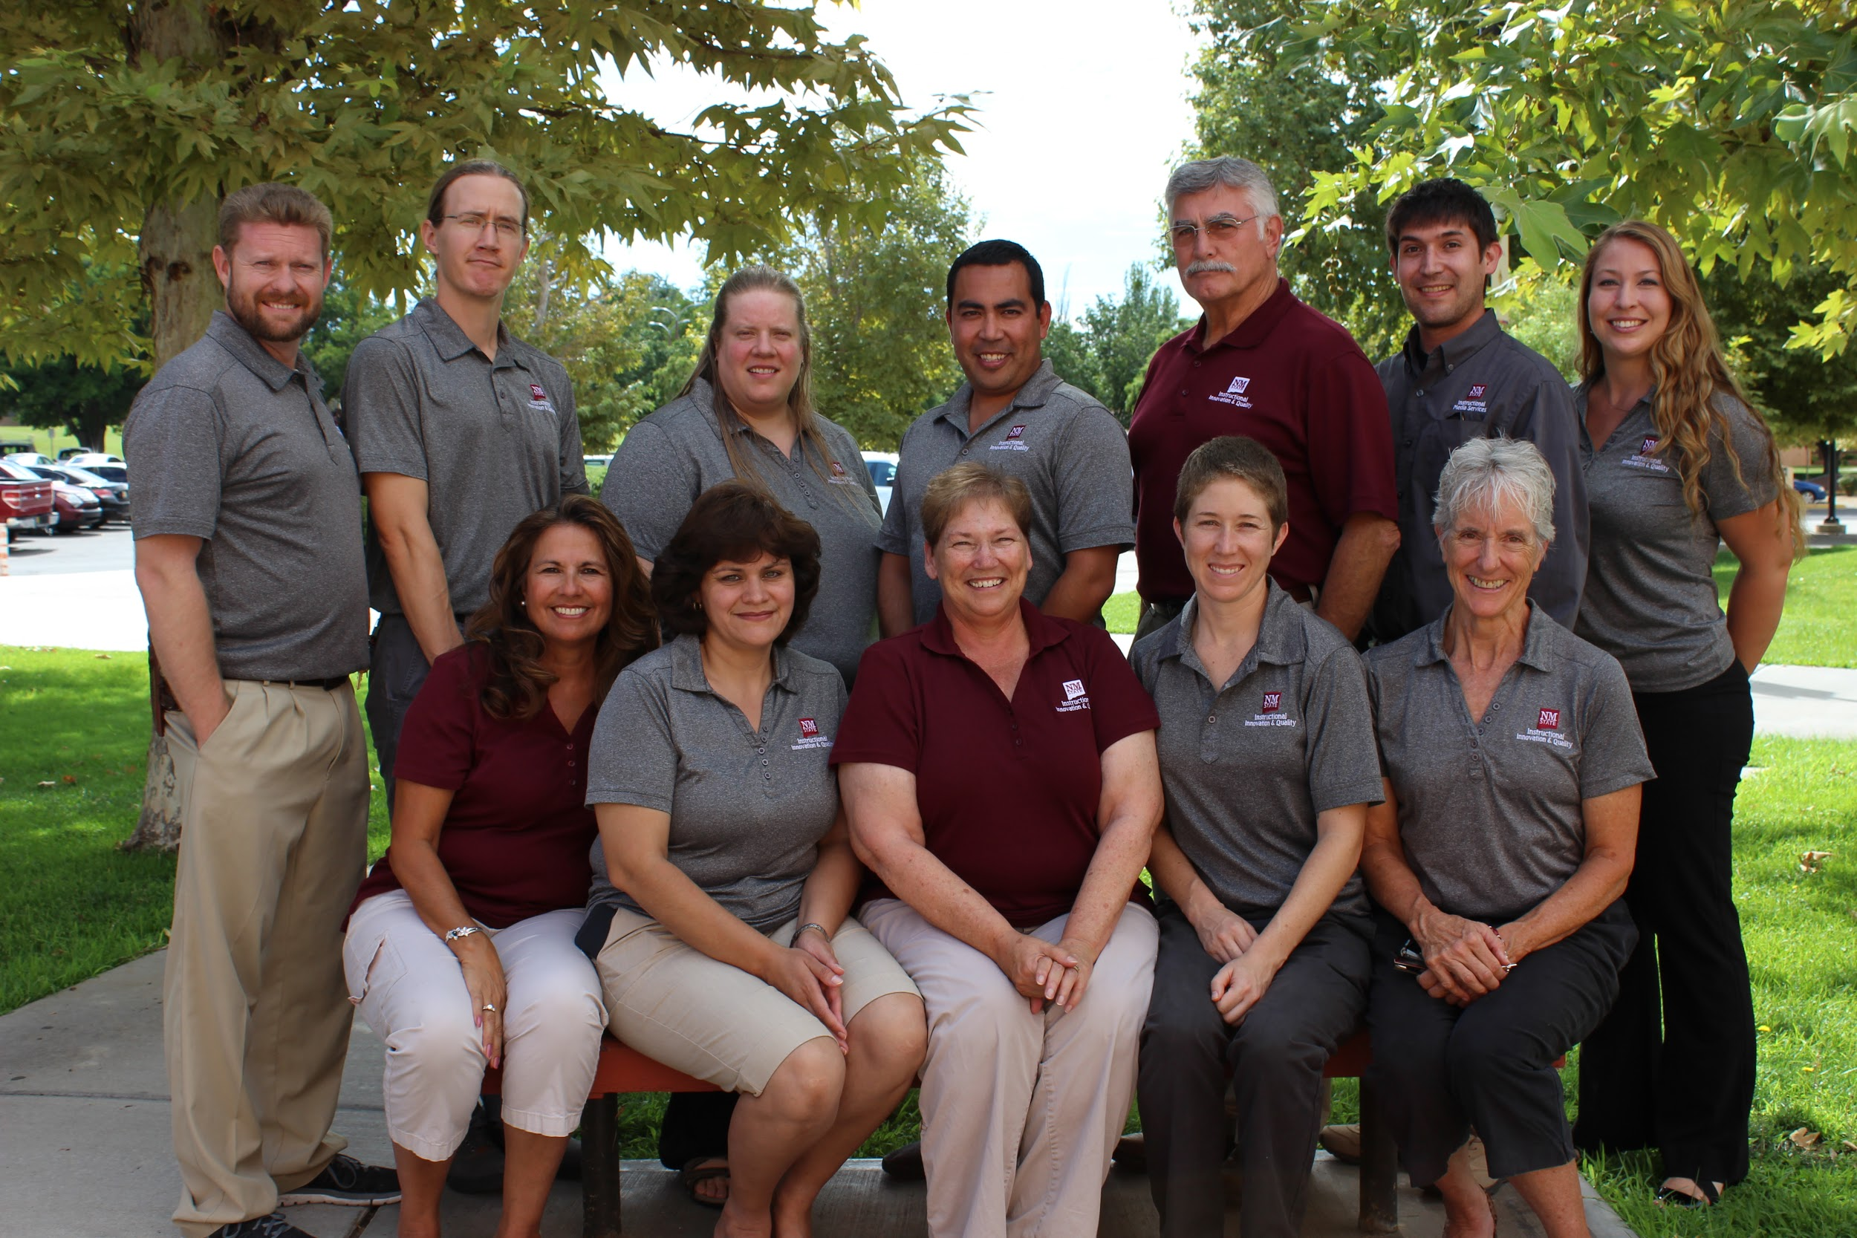
Agenda
Introduce expert panel
Discuss OCIP program
One-Year-Plus Fellowship (1Yr+)
New2Online (N2O)
Discuss how we align to QM
Background on cohorts
Panel discussion
Q & A

Slide 3
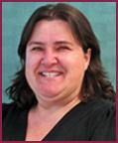
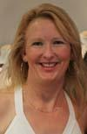
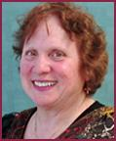
Meet our Expert Panel
Conni DeBlieck DNP, MSN, RN
Laura Madson, PhD
Linda Summers, PhD, FNP-BC, PFNP-BC, RN

Slide 4
What is OCIP?
The Online Course Improvement Program is a partnership with:
Associated Students of New Mexico State University
Student Technology Advisory Committee
Starting in 2012, the Distance Education Course Delivery Fee provides a portion of funding

Slide 5
History of OCIP
OCIP began Fall 2009
One-Year-Plus (1Yr+) started in 2010
New2Online (N2O) Program started in 2013
Summer Camp/Institute started 2014

Slide 6
Program Goals
1. Assist faculty in enhanced web course design and delivery while reducing student's textbook cost.
2. Provide faculty instructional design services with a framework that supports peer interaction and best practices for online learning.
3. Facilitate participation in national digital content consortiums and relevant communities.
4. Create and support a culture of quality for online courses taught at NMSU.
5. Develop a scalable, customized professional development model.

Slide 7
How QM Guides Us
We use the QM standards to guide the learning cycle.
All professional development is aligned to the standards as much as possible.
Sept | Oct | Nov | Dec | Jan | Feb | Mar | Apr
QM1 | QM2 | QM3 | QM4 | QM5 | QM6 | QM7 | QM8

Slide 8
A Quick Tour in Canvas
1Yr+ https://nmsu.instructure.com/courses/872538/modules
N2O https://nmsu.instructure.com/courses/872537/modules

Slide 9
New2Online Program
Designed for faculty who have no experience teaching online/blended
One-on-one mentorship
Currently in our 3rd cohort
Faculty attend 15 professional development hours
Earn $1,000 stipend for successfully fulfilling all N2O requirements
“Give back” presentation or workshop
Recognized at the IIQ Awards Celebration
http://www.quickmeme.com/meme/3ou170
Notes:
Discuss N2O program - Michelle
Discuss 1Yr+ - Miley
Background “fragmented cohort” - Miley
Completion rates in past years and other data - Michelle

Slide 10
One-Year-Plus Fellowship
Designed for faculty who have experience teaching online/blended
One-on-one mentorship
Currently in our 7th cohort
Faculty attend 48 professional development hours, including option for APPQMR
Earn $2,000 stipend for successfully fulfilling all 1Yr+ requirements
“Give back” presentation or workshop
Recognized at the IIQ Awards Celebration

Slide 11
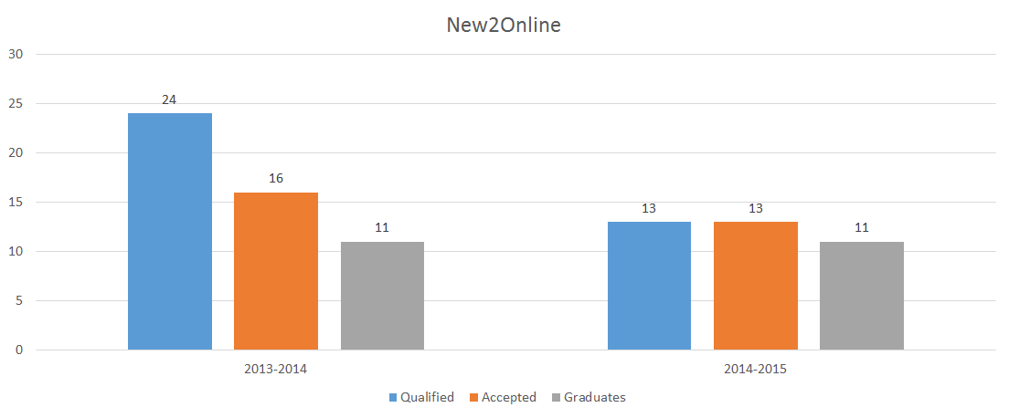
Comparing the years
Notes:
First year, more applicants, but fewer graduates
85% Second year, more selective about who qualified, cohort formation helped with higher graduation rate

Slide 12
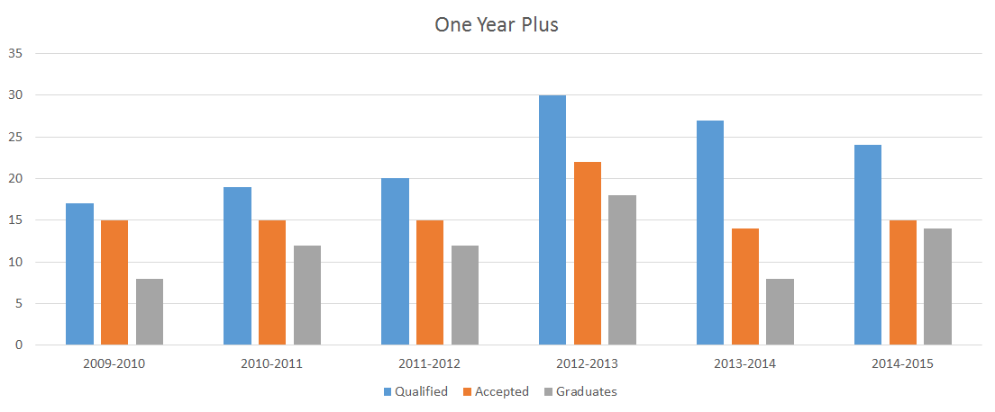
Comparing the years
Notes:
93% completion rate for 2014-15 with the cohorts - highest to-date.

Slide 13
Expert Panel
Conni DeBlieck Nursing
Laura Madson
Psychology
Linda Summers
Nursing
Why did you apply to the OCIP program?
What did you expect?
How did working in a discipline specific cohort influenced your work?
What was the most challenging part of the program for you?
Do you feel that you gained more by working with your peers than you would have working alone?
What advice would you give to any program trying to foster future holistic cohorts? (Strategies to engineer a similar cohort)
What was your biggest take-away?
Additional thoughts?

Slide 14
Questions?

Slide 15
Feel free to contact us!
Miley Grandjean
(575) 646-5492
Michelle Lebsock
(575) 646-7436
email: ocip@nmsu.edu
website: ocip.nmsu.edu
Resource Wiki: ocipresources.nmsu.edu
Tweet us: @nmsuocip #NMSUOCIP
http://bit.ly/1PGsKZV

