Slide 1
CPE Rubric Applied to Government Agency
Anne Arundel Community College, Maryland and Maryland Department of the Judiciary

Slide 2
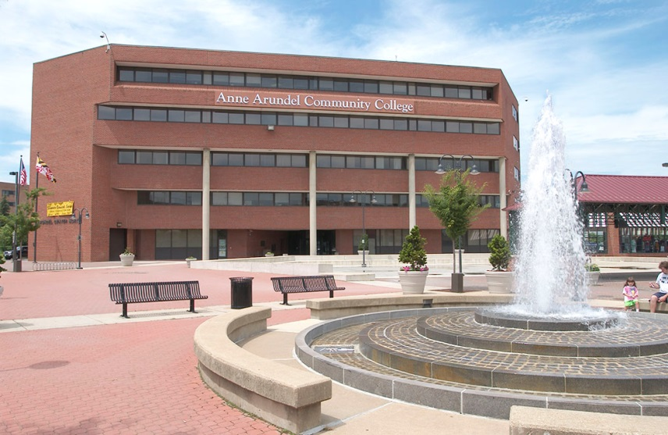
Who are we?
Anne Arundel Community College (MD): Center for Workforce Solutions and the Virtual Campus.
Jennifer Bopp
Consultant: Transforming Leaders, LLC
Dr. Joan McMahon
Maryland Department of the Judiciary’s Office of Professional Development (MDJ-OPD)

Slide 3
Session Outcomes
Showcase a collaborative relationship between the Maryland Judiciary, a community college and Quality Matters.
Demonstrate the use of the Quality Matters Continuing Professional Education Rubric for excellence in online course design.
Apply the QM CPE Rubric to other Judiciary possibilities.

Slide 4
The Needs
Train Maryland Judiciary Trainers to convert over 80 face-to-face courses into e-learning.
Develop the training to meet national quality standards for online course design.
Notes:
23 page RFP

Slide 5
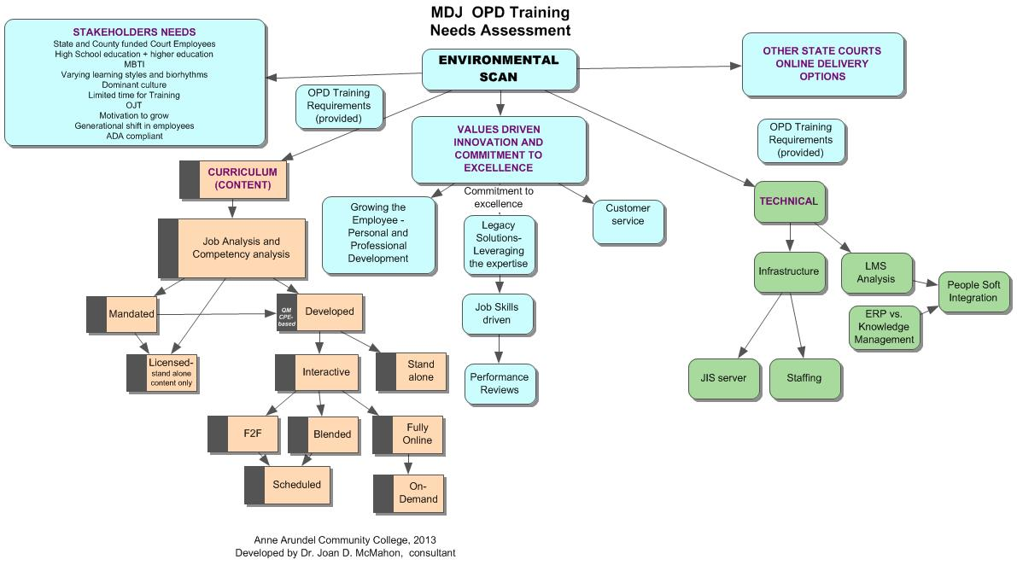
A Picture of the Needs

Slide 6
The Scope of Work Changed….
Original Project Manager, Consultant, and Client changes
More trainers determined
Each trainer to develop their own course
AACC’s LMS Migration (ANGEL to Canvas)
Being flexible, managing project creep, and setting realistic deadlines kept the project on track. This was collaborative.

Slide 7
Project Phases
Phase A: Content and Technical Assessment
Phase B: Teaching and Learning in the e-Learning Environment
Phase C: Development of Pilot Courses using the QM CPE rubric
Phase D: Participant Access Tutorial
Notes:
The course developers/trainers took on online course in Best Practices prior to developing their specific course.

Slide 8
Content and Technical Assessment
Environmental Scan conducted of current training program
How other State Judiciary systems deliver online courses
What were other stakeholders needs
Office of Professional Development (OPD) training requirements
Institutional values driving the Maryland Administrator of the Courts mission
Performance driven curriculum options without specific standards.
SWOT Analysis
Strengths, Weaknesses, Opportunities/Obstacles, Threats
Notes:
During these phases MDJ devoted the resources to meet the deliverables

Slide 9
Introducing the QM CPE Rubric
Opportunity for MDJ to become a National benchmark model for excellence in Judicial education
Strength in established values shaped quality of the programs
Opportunity for trainers and Stakeholders to grow
QM CPE Rubric was the tool for excellence in Course Design
Notes:
Maryland Judiciary has the potential to become the national benchmark model for excellence in Judicial education
Following established values will shape the quality of the programs
Stakeholders will grow through professional development programs; therefore the organization will grow

Slide 10
Technical Assessment
Best Recommendation
Partner with AACC and use their Canvas LMS
Technical team saw the value in the QM CPE Rubric to adopt throughout all MDJ trainings, including technical training.
Notes:
Baseline in order to use a current LMS’s—to roll out SU14, perfect timing…course development will be complete by May.

Slide 11
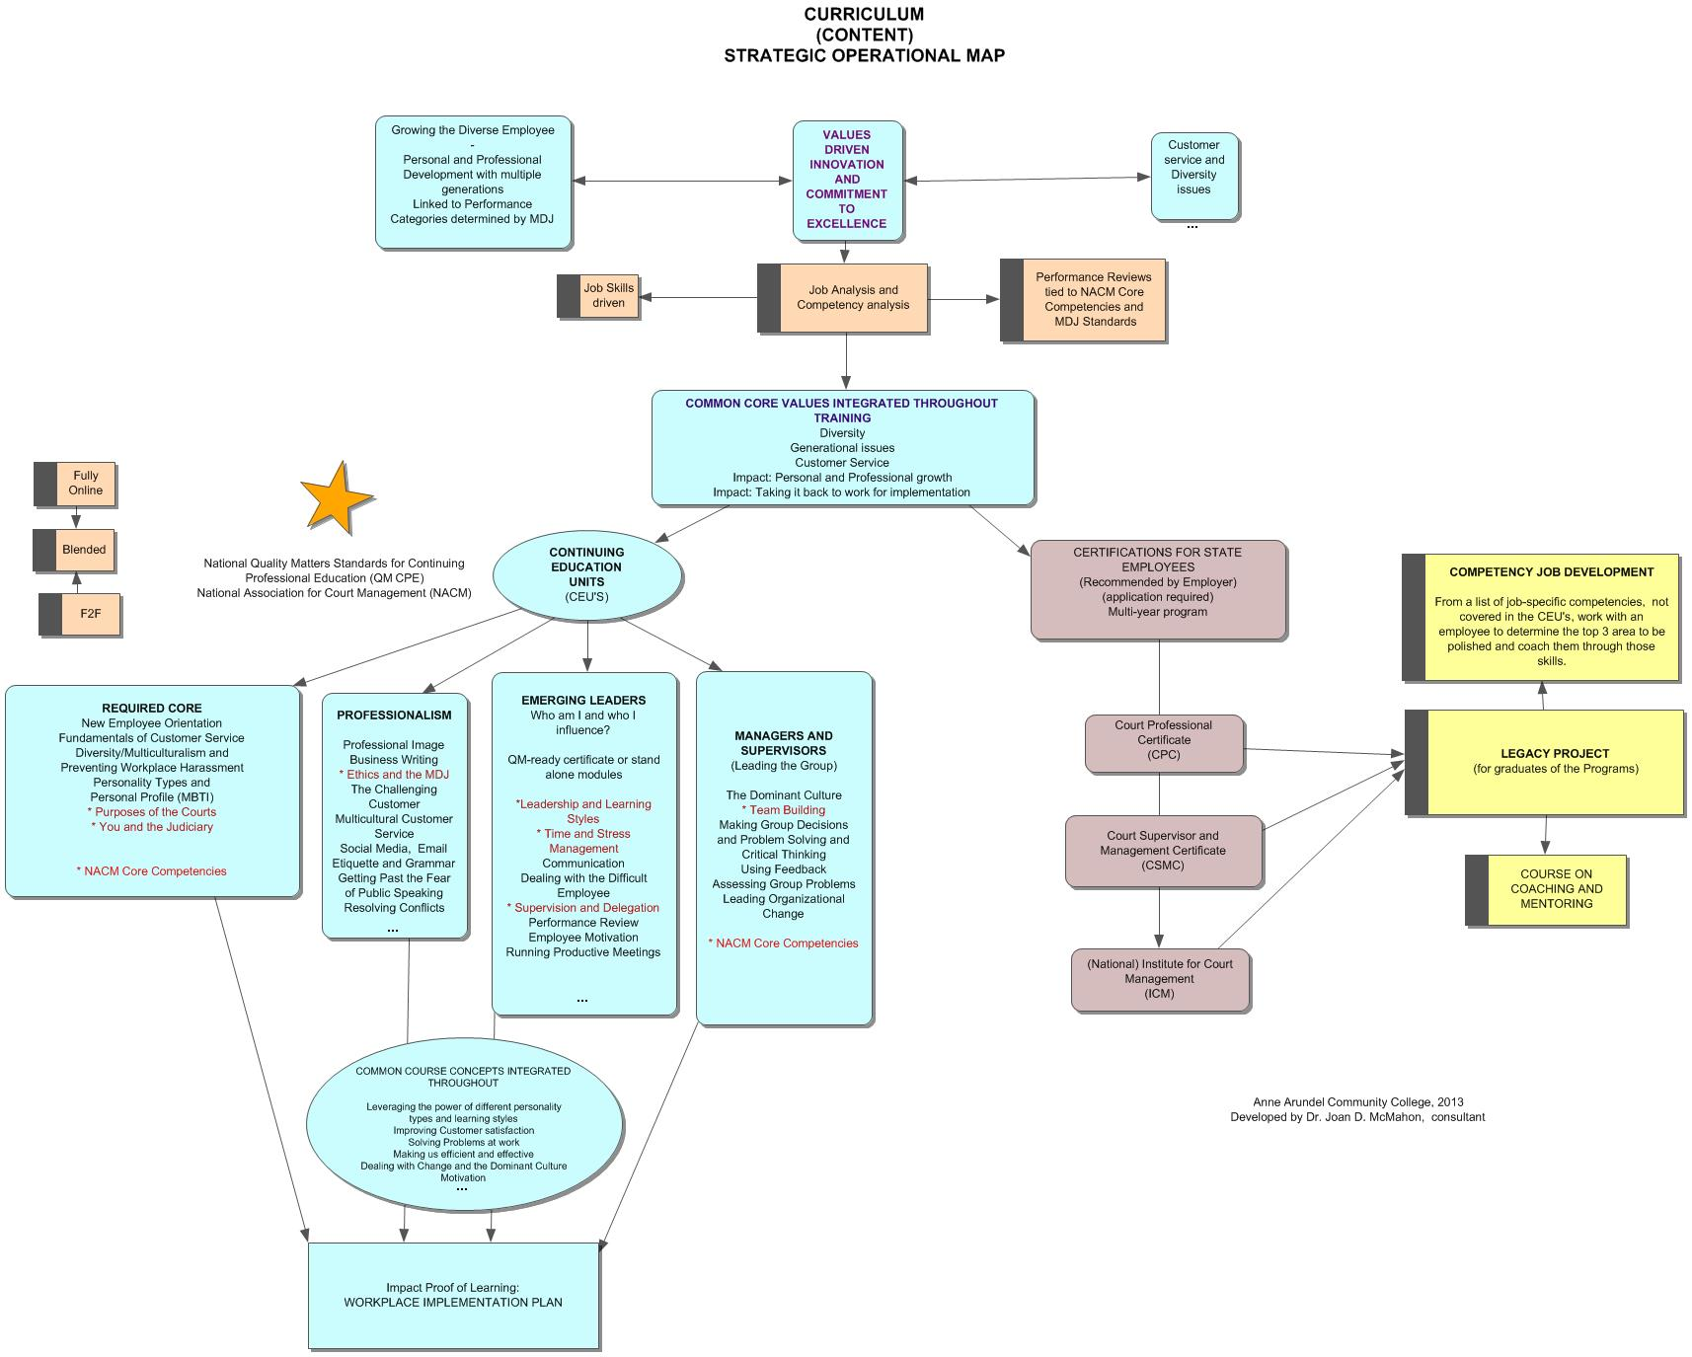
A Picture of the Curriculum
Notes:
Pre-requisites led to Tracks.
Performance Standards led to course objectives

Slide 12
Values were in alignment with the CPE Rubric
Using the QM CPE Rubric, the 8 key standards shaped the curriculum. A Commitment to Excellence was a key value.
The Core Values were explicitly stated and on every desk.
QM CPE requirement of pre-requisites forced curricular decisions (tracks)
Notes:
AACC’s online faculty training
Customized

Slide 13
Changes in the Course Designers (Trainers)
In using the CPE Rubric, trainers
Gave up “Sage” role.
Challenged to re-think their new role and those of their learners
Used aligned Course Map to plan meaningful interactive online activities
Designed workplace assessments that were authentic and job specific (personal implementation plan)
Planned aligned accountability -Show and Tell was done weekly (impact related)

Slide 14
Keys to Success
Specific, detailed quote with clear deliverables
Kick-off meeting, setting expectations with the Maryland Judiciary
Project planned with detailed task list and deadlines
Consultant paid based on key deliverables
Consultant maintained excellent relationship with trainers
Project management
Deadlines met with high quality deliverables
Weekly reports from consultant to AACC
Manage “scope creep” by limits of agreement
Consultant introduced value of Quality Matters to client
Course Maps designed around CPE Standards
Best practices in online learning can be customized for professional development.
Notes:
A well coordinated team of project management, client and consultant services.

Slide 15
Impact
QM CPE was a benchmark for all MDJ training, even outside OPD
Supported by the top administrators
Trainers rejuvenated and motivated
Policies were re-examined (Training = pay for performance)
Learner success was tied to measurable performance - learner outcome driven and interactive
Notes:
Maryland Judiciary has the potential to become the national benchmark model for excellence in Judicial education
Following established values will shape the quality of the programs
Stakeholders will grow through professional development programs; therefore the organization will grow

Slide 16
Status Today: Legacy
Quality Matters Continuing & Professional Education Rubric used as guiding principle for all OPD online courses.
Movement to use CPE Rubric for other MDJ training institutes, regardless if on-ground or on-line.

Slide 17
Q & A’s

Slide 18
Contact Information
Learning Advancement and the Virtual Campus www.aacc.edu/virtualcampus Jennifer Bopp jlbopp@aacc.edu 410-777-2629
Transforming Leaders, LLC Dr. Joan McMahon mcmahon@towson.edu 410-733-0029

