Slide 1
All Courses Rise with the Tide -
Raising the QM Sails at a Large Institution

Slide 2
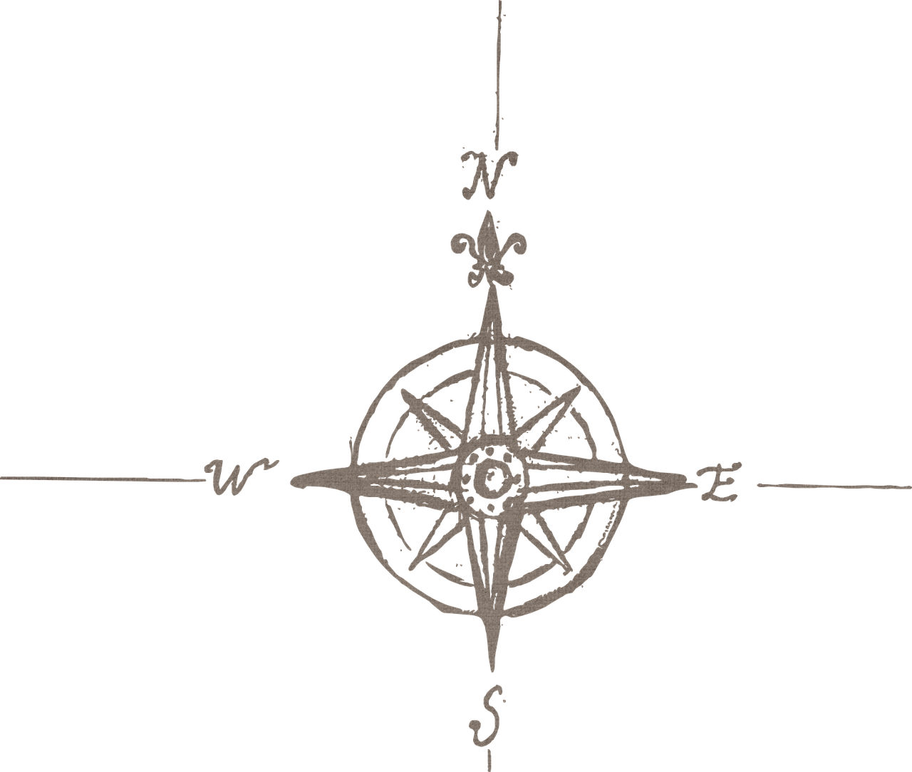
CHARTING OUR COURSE
Who we are
Why Quality Matters
Our QM timeline
Laying the groundwork
Early adoption & implementation strategies
Expansion & managing change

Slide 3
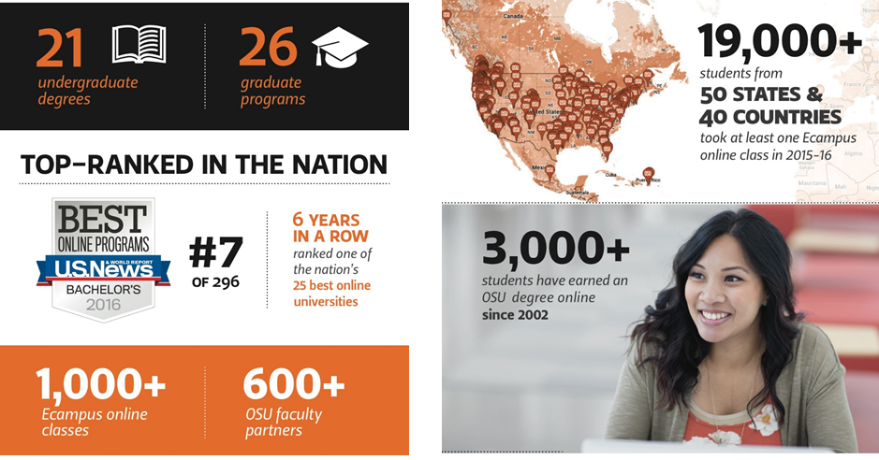
ECAMPUS AT A GLANCE

Slide 4
ECAMPUS ORGANIZATION
Marketing & Enrollment Services
Department and Learner Services
Course Development & Training
Research Unit

Slide 5

Marketing and Enrollment Services (MES)
Marketing & Enrollment Services
Department of Learner Services
Course Development & Training
Market research for new programs
Targeted and broad degree marketing
Ecampus website
Enrollment services for prospects
Customer relationship management (CRM) tracking of inquiries
Executive/internal communications and marketing
Samantha Diaz
B.S. in Psychology
Manteca, California

Slide 6

Department and Learner Services (DLS)
New program curricular reviews and online course scheduling
Test proctoring
Academic counseling
Career services
Marketing & Enrollment Services
Department of Learner Services
Course Development & Training
Kristina Trevino
Master of Natural Resources
San Antonio, Texas

Slide 7
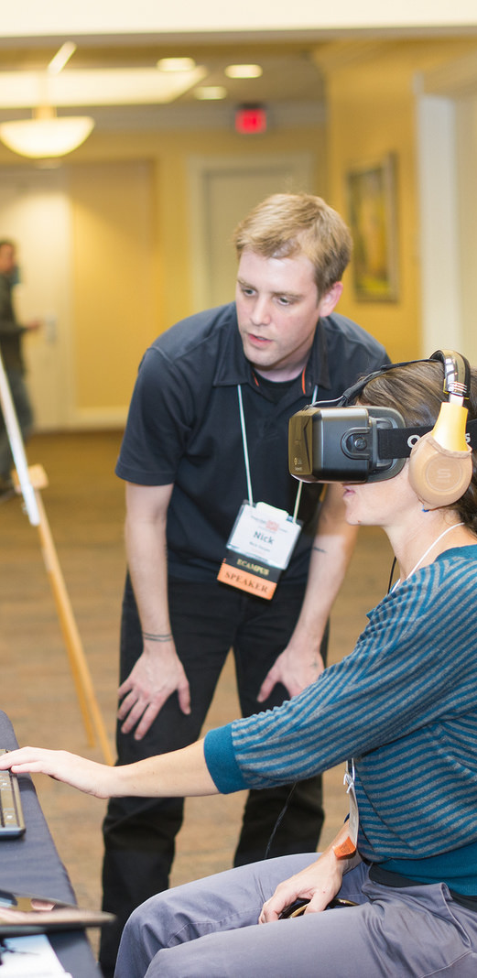

Course Development and Training (CDT)
Marketing & Enrollment Services
Department of Learner Services
Course Development & Training
Full service instructional design model
Research-based course designs
Award-winning faculty development & training
QM pre-reviews, formal reviews & training
Open content design & production
Media development including videography and custom programming

Slide 8

Ecampus Research Unit
Course Development & Training
Conduct original research on distance education best practices
Assist faculty in conducting distance education research through providing funding and professional development
Grant writing and research collaborations
Marketing & Enrollment Services
Department of Learner Services

Slide 9

WHY QUALITY MATTERS
Validate quality
Raise the bar
Differentiate ourselves
Foundation for growth

Slide 10
OUR QM TIMELINE
Laying the Groundwork
Introduce QM
Faculty buy-in
Expansion
Widespread QM template implementation
Early Adoption
Process development
Template development
Early certifications
Moving Forward
Refining the process
Internal marketing
Program certification
2012
2013
2014
2015
2016
2017

Slide 11
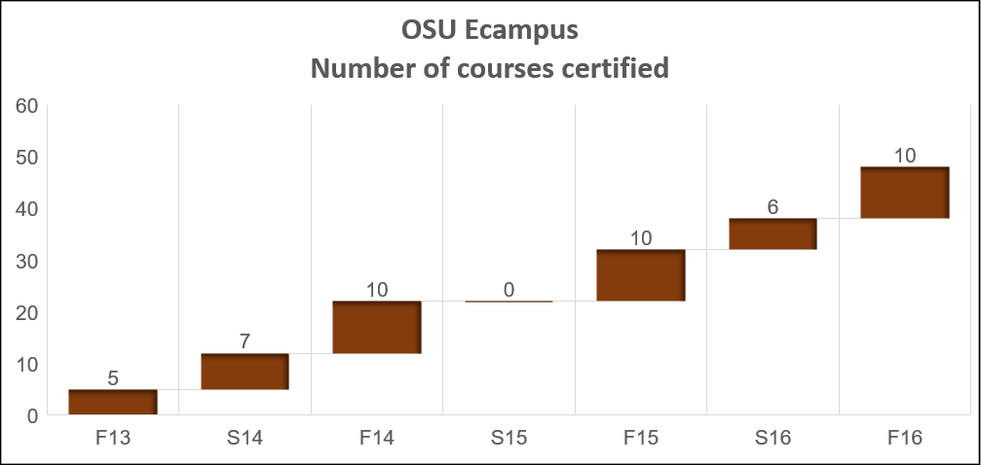
METRICS

Slide 12

STRATEGIES SHAPING EARLY IMPLEMENTATION
Make QM a ‘sticky’ idea

Slide 13
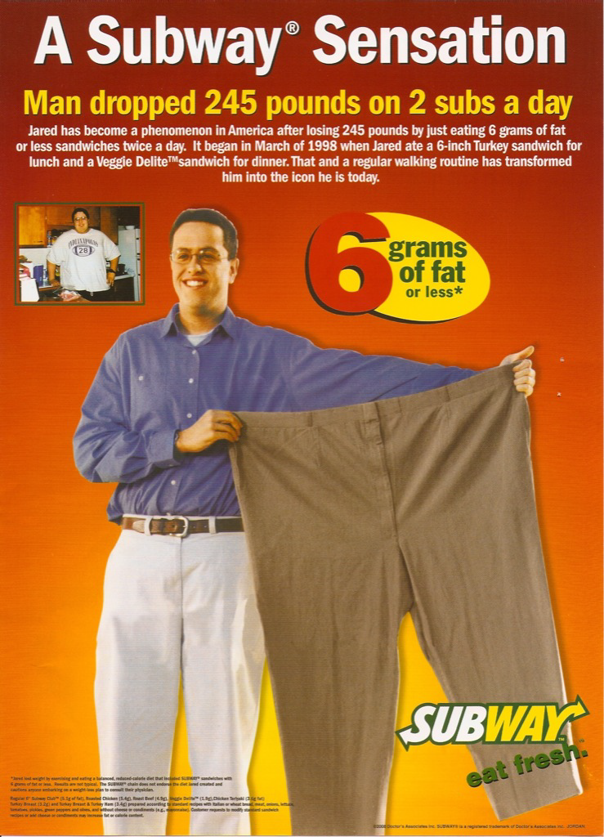

STRATEGIES SHAPING EARLY IMPLEMENTATION

Slide 14

STRATEGIES SHAPING EARLY IMPLEMENTATION
Principles of creating ‘sticky’ ideas –
Simple – express the essential core

Slide 15

STRATEGIES SHAPING EARLY IMPLEMENTATION
Principles of creating ‘sticky’ ideas –
Simple – express the essential core
Concrete

Slide 16
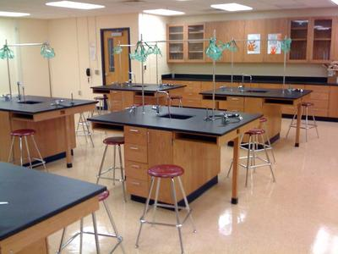
STRATEGIES SHAPING EARLY IMPLEMENTATION
Principles of creating ‘sticky’ ideas –
Simple – express the essential core
Concrete

Slide 17

STRATEGIES SHAPING EARLY IMPLEMENTATION
Principles of creating ‘sticky’ ideas –
Simple – express the essential core
Concrete

Slide 18

STRATEGIES SHAPING EARLY IMPLEMENTATION
Principles of creating ‘sticky’ ideas –
Simple – express the essential core
Concrete
Credible

Slide 19
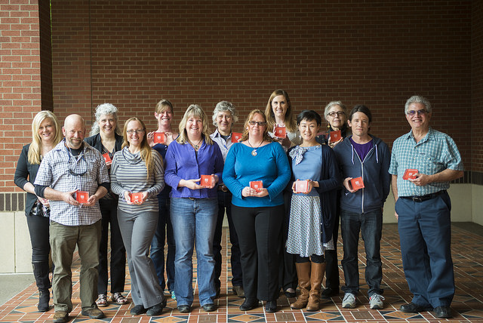
STRATEGIES SHAPING EARLY IMPLEMENTATION
Principles of creating ‘sticky’ ideas –
Simple – express the essential core
Concrete
Credible
Generate emotion

Slide 20

STRATEGIES SHAPING EARLY IMPLEMENTATION
Principles of creating ‘sticky’ ideas –
Simple – express the essential core
Concrete
Credible
Generate emotion
Unexpected

Slide 21
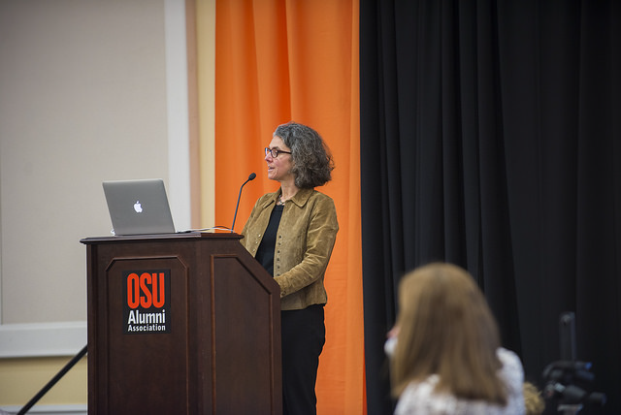
STRATEGIES SHAPING EARLY IMPLEMENTATION
Principles of creating ‘sticky’ ideas –
Simple – express the essential core
Concrete
Credible
Generate emotion
Unexpected

Slide 22
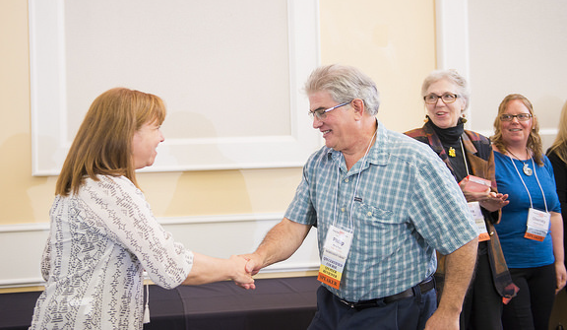
STRATEGIES SHAPING EARLY IMPLEMENTATION
Principles of creating ‘sticky’ ideas –
Simple – express the essential core
Concrete
Credible
Generate emotion
Unexpected

Slide 23
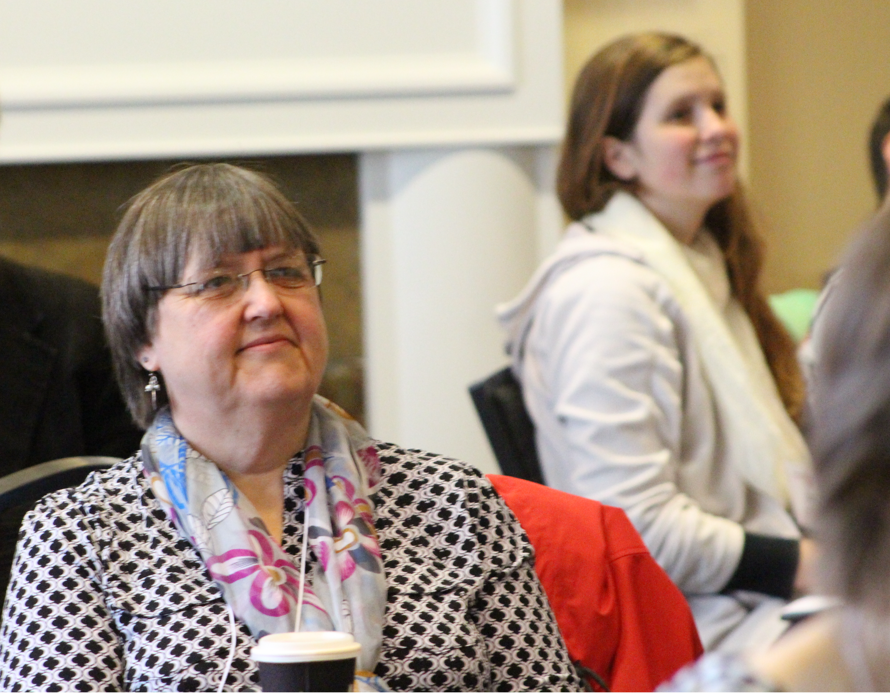
STRATEGIES SHAPING EARLY IMPLEMENTATION
Principles of creating ‘sticky’ ideas –
Simple – express the essential core
Concrete
Credible
Generate emotion
Unexpected
Expressed through story

Slide 24
STRATEGIES SHAPING EARLY IMPLEMENTATION
“I just want to say that I thought the class was EXCELLENT… This was the first online class I've taken. I admit that I was initially hesitant, but . . . it turned out not only good but the best class I've taken yet at OSU! I am sure that is due almost entirely to how you ran the course. ”
– Quote from student in Kuuipo Walsh’s QM-certified course

Slide 25
QUESTION
When introducing QM what is one message or image you found to be particularly compelling with your faculty?

Slide 26

EARLY ADOPTION
Course templates based on QM standards
Providing QM training
In-depth pre-reviews by Ecampus instructional designers
Guidance and support for course modifications
Coordination of review teams
Recognition of QM Certified courses

Slide 27
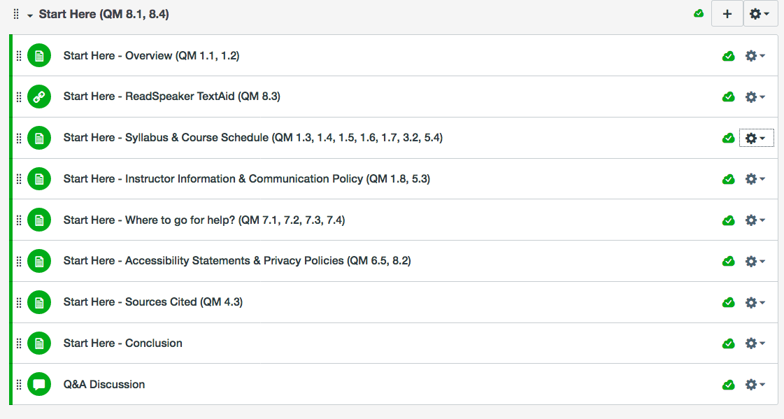
EARLY ADOPTION
Course templates based on QM standards

Slide 28
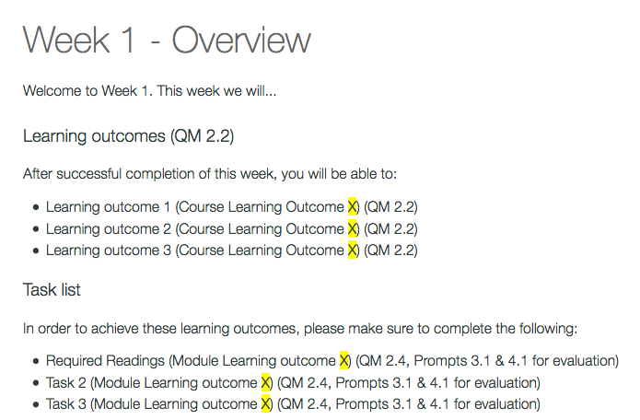
EARLY ADOPTION
Module Overview Page
  Standards:
    2.2
    2.4
    3.1
    4.1

Slide 29

EARLY ADOPTION
Course templates based on QM standards
Providing QM training

Slide 30

EARLY ADOPTION
Course templates based on QM standards
Providing QM training
In-depth pre-reviews by Ecampus instructional designers

Slide 31

EARLY ADOPTION
Course templates based on QM standards
Providing QM training
In-depth pre-reviews by Ecampus instructional designers
Guidance and support for course modifications

Slide 32

EARLY ADOPTION
Course templates based on QM standards
Providing QM training
In-depth pre-reviews by Ecampus instructional designers
Guidance and support for course modifications
Coordination of review teams

Slide 33
EARLY ADOPTION
Results with pre-reviews

Slide 34


EARLY ADOPTION
Course templates based on QM standards
Providing QM training
In-depth pre-reviews by Ecampus instructional designers
Guidance and support for course modifications
Coordination of review teams
Recognition of QM certified courses

Slide 35
QUESTION
As part of your QM implementation strategy, what tools and approaches have you used to get a faculty member interested in participating in a review?

Slide 36

EXPANSION
Challenge – Change learning management system

Slide 37
EXPANSION
“If we move it, we improve it”

Slide 38
Metrics

Slide 39
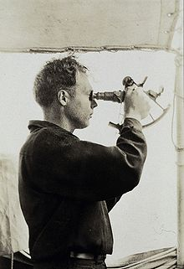
IDENTIFYING MOMENTS OF OPPORTUNITY
“You have to have the ability to ‘see’ the possibilities, see potential waste, see the flow of things, see where things might get stuck. By ‘seeing’ we mean the lens that you put over your eyes as you look at a change. What lens you choose to use is directly correlated to how effective you are as an individual and as a team.”
-Keith Yamashita (SY Partners)

Slide 40

IDENTIFYING MOMENTS OF OPPORTUNITY
Keep your strategic priorities in mind when change arrives

Slide 41

EXPANSION
Move to online APPQMR only
Leveraging relationships to identify faculty

Slide 42

CHALLENGES MOVING FORWARD
Creative staffing support
Integrating QM more deeply in the culture of the organization
Making QM certification more attractive

Slide 43

FUTURE DIRECTIONS
Focus on internal marketing
Program certification…

Slide 44
References
Canvas Faculty Resources – OSU Ecampus Course Template. (2016). http://ecampus.oregonstate.edu/faculty/canvas/
Heath, C. & Heath, D. (2008). Made to stick: Why some ideas survive and others die. New York: Random House.
Yamashita, K. [99U]. (2012, Dec. 19). Keith Yamashita: The 3 habits of great creative teams. [Video File]. Retriefed from https://www.youtube.com/watch?v=Tcjv84GSJr0.
Images in this presentation not cited are from Pixabay.com – all are CC0 Public Domain

Slide 45

QUESTIONS??

