Slide 1
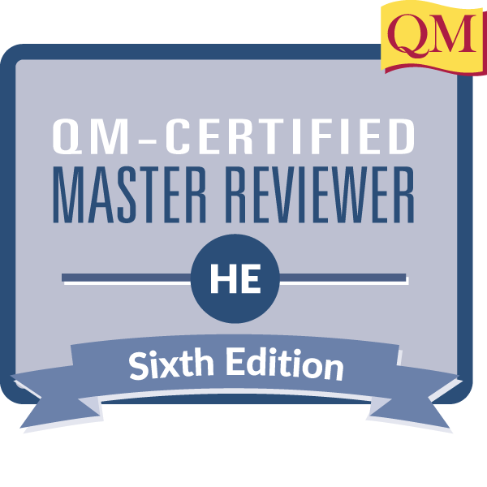
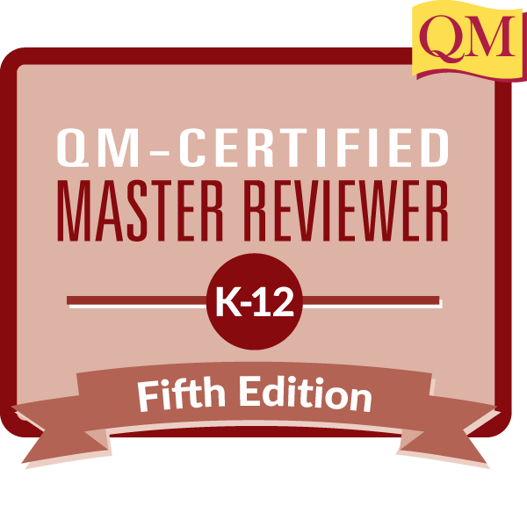
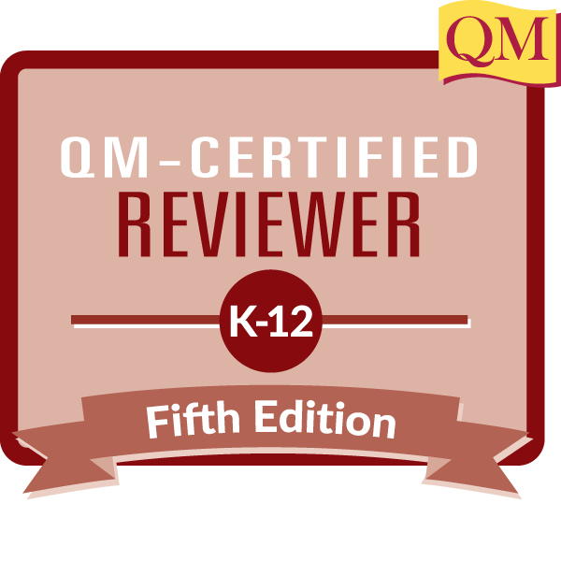
Designing a Peer Evaluation Rubric
With Quality Matters in Mind
Quality Matters Connect Conference | Beyond the Classroom Session | Nov. 7, 2022
Melony Shemberger, Ed.D.
Associate Professor, Mass Communication
Murray State University
Murray, Kentucky

Slide 2
SESSION OBJECTIVES
Review current peer evaluation rubrics or processes in order to determine important components for inclusion in a revised evaluation instrument.
Identify components of an existing peer evaluation instrument or rubric to rewrite in order to reflect Quality Matters standards.
Rewrite components of a peer evaluation instrument or rubric so that it models standards in the Quality Matters Rubric.
2

Slide 3
Evaluations
Just as the diagnosis of a disease is required first, to promote teaching reform, it is necessary to have a clear understanding of the current situation of evaluations (Li & Hu, 2022).
3

Slide 4
WHAT ISSUES HAVE YOU EXPERIENCED WITH PROFESSIONAL, CLASSROOM, OR STUDENT EVALUATIONS?

Slide 5
PRESENTATION SKILLS
ARTICULATION
PRONUNCIATION

Slide 6
CONTEXT
More than 16,000 higher education institutions administer student evaluations at the end of each teaching period (Heffernan, 2022).
Student evaluations are influenced by racist, sexist and homophobic prejudices, and are biased against discipline and subject area. Evaluations are heavily influenced by student demographics, the teaching academic's culture and identity, and other aspects not associated with course quality or teaching effectiveness. Student comments are abusive, mostly directed toward women and those from marginalized groups. Still, student evaluations are a measure of performance and play a role in hiring, firing and promotional decisions (Heffernan, 2022).
Student evaluations of teaching are widely believed to contain gender bias. A relatively simple intervention in language can potentially mitigate gender bias in student evaluation of teaching (Peterson, Biederman, Andersen, Ditonto, & Roe, 2019).
6

Slide 7
BUILDING A BETTER EVALUATION
Supervisors and administrators should use the best available tools to strengthen the credibility of faculty teaching evaluations and prevent unfair personnel decisions affecting underrepresented subgroups in academia by gender, race, or ethnicity (Valencia, 2022).
7

Slide 8
BUILDING A BETTER EVALUATION
Efforts to de-emphasize quantitative student evaluations of teaching data to address issues such as bias can be strengthened through the integration of performance appraisal tools that clearly articulate performance criteria and standards and that gather both qualitative and quantitative data on employee performance (Lohman, 2021).
8

Slide 9
FACILITATION COURSE DESIGN
To facilitate a course that demonstrates impactful teaching, course design is equally important.
9

Slide 11
QUALITY MATTERS STANDARDS (HE)
GENERAL STANDARD 2
GENERAL STANDARD 3
GENERAL STANDARD 4
Learning Objectives
Assessment & Measurement
Instructional Materials
GENERAL STANDARD 5
GENERAL STANDARD 6
Learning Activities & Learner Interaction
Course Technology
11

Slide 12
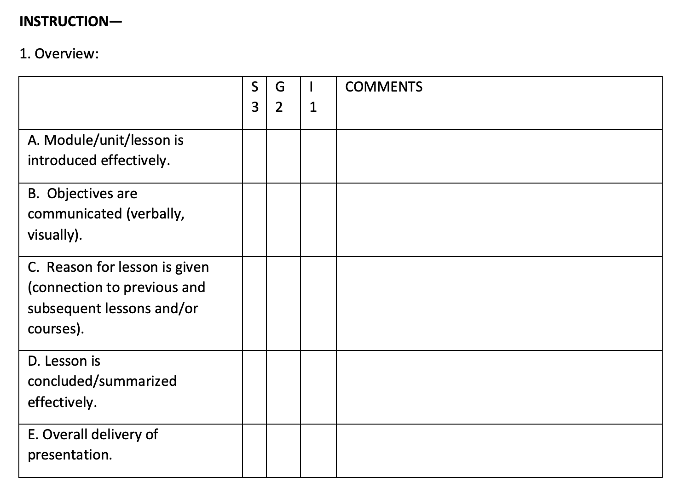
GENERAL STANDARD 2

Slide 13
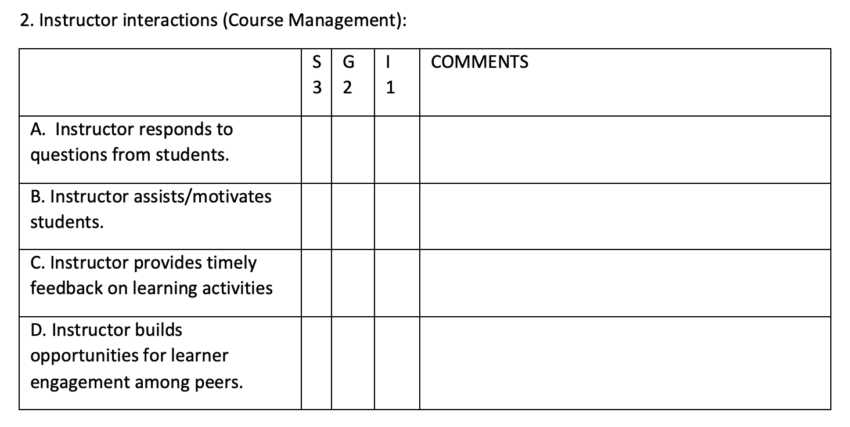
GENERAL STANDARD 5

Slide 14
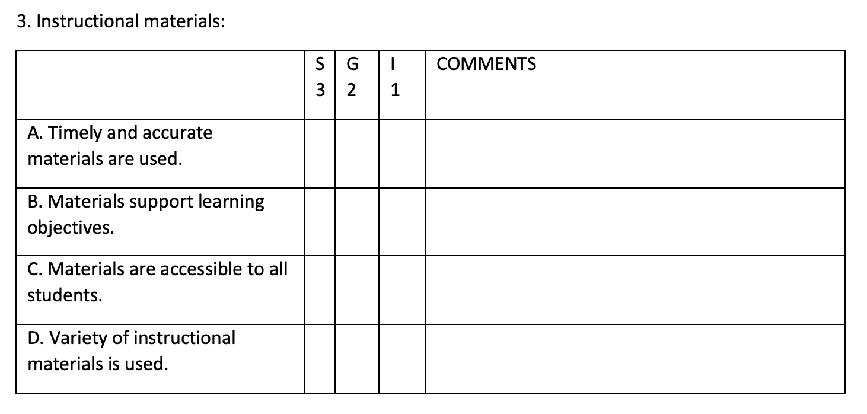
GENERAL STANDARD 4

Slide 15
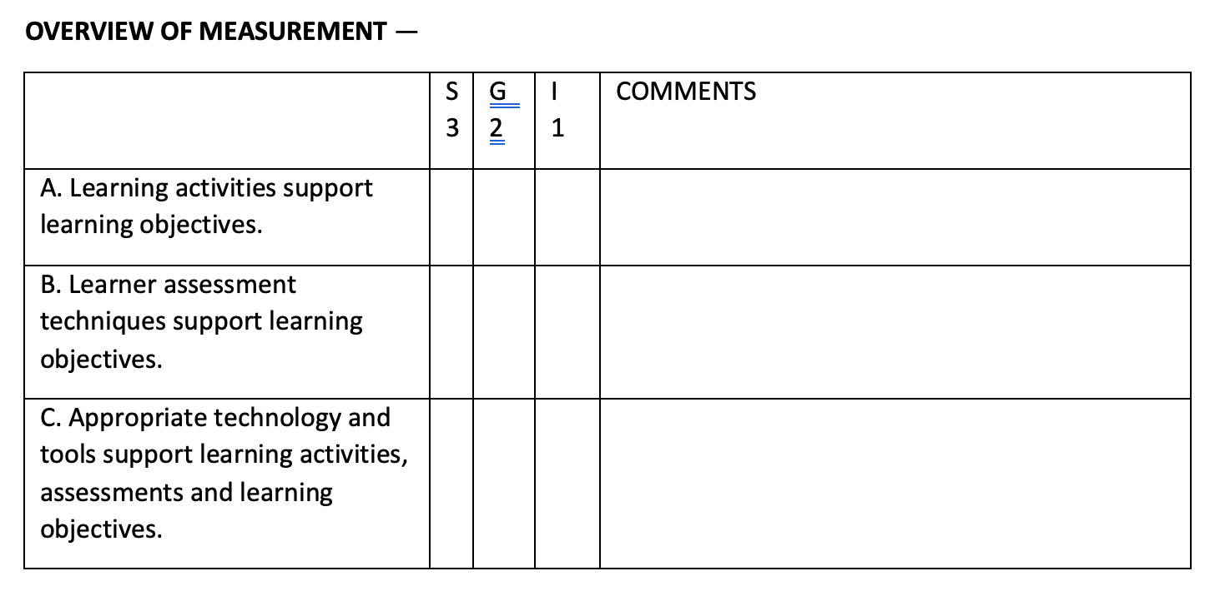
GENERAL STANDARDS 3, 5, 6

Slide 16
PROCESS & IMPLEMENTATION
 | JAN | FEB | MAR | APR | MAY | JUN
PHASE 1
 |  | Jan 1 - Mar 30
T&P Review
 | Jan 1-27
Chair Review
 |  | Feb 1 - Mar 30
PHASE 2
 |  |  |  | Apr 1 - Jun 25
Dept. Review
 |  |  |  | Apr 1 - 23
Prep
 |  |  |  |  | May 1 - Jun 25
16

Slide 17
Lessons to consider
Review QM Rubric with colleagues.
Faculty development sessions
Exercise patience.
Faculty resistance
Develop a repository or resource.
QM presence
Revisit peer review process often.
Currency
17

Slide 18
SESSION OBJECTIVES
Review current peer evaluation rubrics or processes in order to determine important components for inclusion in a revised evaluation instrument.
Identify components of an existing peer evaluation instrument or rubric to rewrite in order to reflect Quality Matters standards.
Rewrite components of a peer evaluation instrument or rubric so that it models standards in the Quality Matters Rubric.
18

Slide 19
REFERENCES
Heffernan, T. (2022). Sexism, racism, prejudice, and bias: a literature review and synthesis of research surrounding student evaluations of courses and teaching. Assessment & Evaluation in Higher Education, 47(1), 144–154. https://doi-org.ezproxy.waterfield.murraystate.edu/10.1080/02602938.2021.1888075
Li, Y., & Hu, C. (2022). The evaluation index system of teaching quality in colleges and universities: Based on the CIPP Model. Mathematical Problems in Engineering, 1–8. https://doi-org.ezproxy.waterfield.murraystate.edu/10.1155/2022/3694744
Lohman, L. (2021). Evaluation of university teaching as sound performance appraisal. Studies in Educational Evaluation, 70, N.PAG. https://doi-org.ezproxy.waterfield.murraystate.edu/10.1016/j.stueduc.2021.101008
Peterson, D. A. M., Biederman, L. A., Andersen, D., Ditonto, T. M., & Roe, K. (2019). Mitigating gender bias in student evaluations of teaching. PLoS ONE, 14(5), 1–10. https://doi-org.ezproxy.waterfield.murraystate.edu/10.1371/journal.pone.0216241
Valencia, E. (2022). Gender-biased evaluation or actual differences? Fairness in the evaluation of faculty teaching. Higher Education (00181560), 83(6), 1315–1333. https://doi-org.ezproxy.waterfield.murraystate.edu/10.1007/s10734-021-00744-1
19

Slide 20
DO YOU HAVE ANY QUESTIONS?
THANK YOU!
@DrMelShemberger
Melony Shemberger, Ed.D.
mshemberger@murraystate.edu
linkedin.com/in/ml2007

