Slide 1
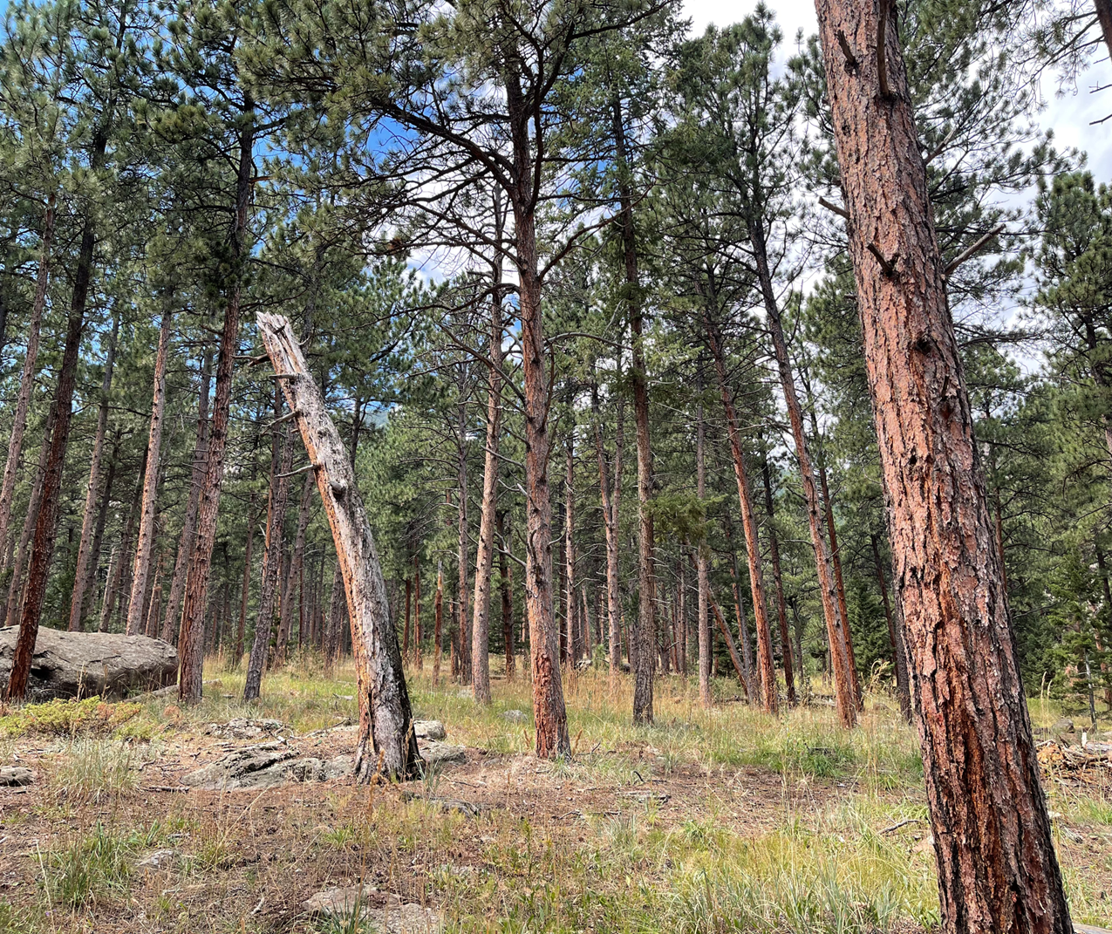
Quality Assurance to Benchmarking:Our Journey
Karen Gorton, PhD, RN, FNP, MS
Oksana Wasilik, PhD

Slide 2
Who are you?
What is your work setting and role?
What do you want to learn from this presentation?

Slide 3
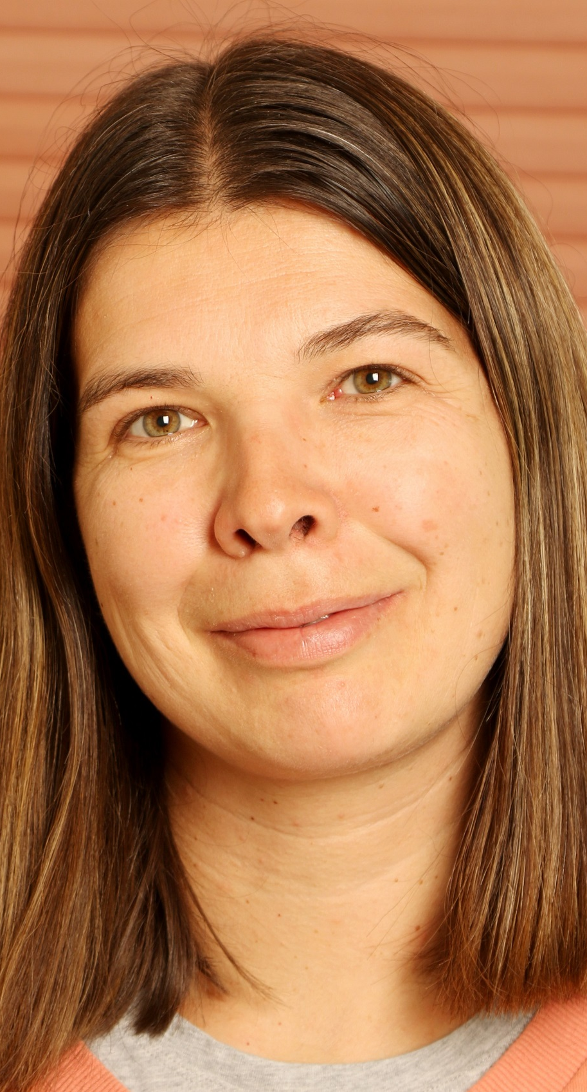
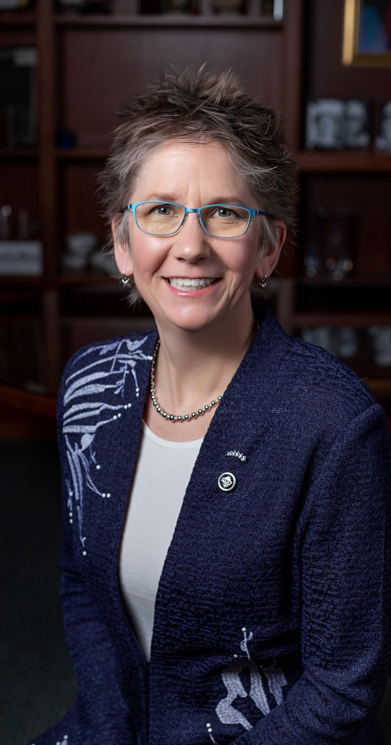
Who are we?
Karen
Oksana

Slide 4
Learning Objectives
Describe one process of curricular update as required by accreditation, using Quality Matters (QM) standards.
Analyze our process and provide suggestions on the pathway to QM benchmarking.

Slide 5
Theoretical Framework: The Online Learning Quality Pie

Slide 6
Why are we considering QM across the curriculum?
Nursing
External accreditation
New Standards
New Essentials: Core Competencies for Professional Nursing Education
External stakeholders
Clinical practice sites
Communities
University
New Vice Provost for Online & Continuing Education
Online and Digital Learning Team with improved support and access
Hired 3 new instructional designers in 2024 (100% increase)
Focus on Quality of Online and Digital Learning

Slide 7
The People
Nursing faculty
Novice educators, expert clinicians
Teaching in BSNc programs
Learning about curricular design
Curricular mapping
Gaps addressed
Iterative process
Instructional Designers
Gaps identified
4 Instructional Designers in Design Cycle work
Engaged with
Faculty Development
Quality Assurance
1 Media Specialist
And 1 librarian – outside of the ID group

Slide 8
The Process: Curriculum Redesign / Mapping
Current courses mapped in Fall 2023 to new accreditation standards
Gaps identified
New program learning outcomes created during Winter 2024
Courses updated in Spring 2024 for implementation in Fall 2025
All courses with new course learning outcomes
Some courses with new course descriptions
New courses re-mapped in Fall 2024
New gaps identified
New gaps addressed
One new templated course developed in collaboration with the Design Cycle Process – Fall 24

Slide 9
Alignment between CCNE and QM Standards
CCNE Standard III | QM Standards
Program Quality: Curriculum and Teaching-Learning Practices – 12 Key Elements | SRS 4.4. Instructional materials represent up-to-date theory and practice in the discipline
 | GS 5. Learning Activities and Learner Interaction
 | GS 2 – Learning Objectives (Competencies)
 | GS 3 – Assessment and Measurement

Slide 10
The Process: Where We Are Presently
Spring 2024
Eight nursing faculty completed the QM TOC in spring 2024
7 workshops
Cost
Time commitment
Fall 2024
One course redesign completed
New course to be used as template for other courses
Faculty member is QM certified
Spring 2025
Nine nursing courses undergoing course development
Course design from Fall 2024 being used as a master template
Four Instructional Designers working with 9 Nursing Faculty
Implementation in the spring
Fall 2024– Spring 2025
Three nursing faculty participating in Teaching Online Learning Community in fall 2024- spring 2025
Reading Small Teaching Online book in the fall
Summer 2025 and Beyond
Next steps
3 more Nursing courses going through Design Cycle
QM Official Course Review for 13 redesigned courses ?

Slide 11
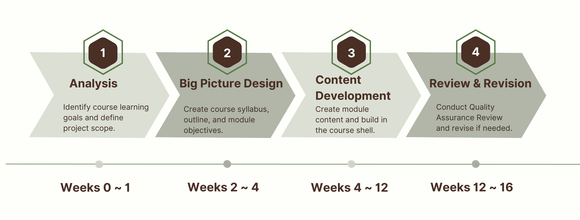
Four Design Phases
Retrieved from https://www.uwyo.edu/ctl/divisions-and-initiatives/online-and-digital-learning/online-course-design-cycle.html

Slide 12
The Process – Course Redesign
Courses in the BSNc program are unique
8 weeks in length, 2 credits each
Courses taught two times per semester
In alignment with the statewide ReNEW Curriculum
Students can be concurrently enrolled in the courses at UW as well as at their community college
Pilot course completed and reviewed – fall 2024
Course met internal Quality Assurance (QA) standards.
Pilot course serves as course template for the next 12 courses in development.

Slide 13
QM Implementation Model
???
Fall 2024 - present
Spring –Summer 2024

Slide 14
Next steps
Finish the update for the remaining 12 BSNc (Bachelor of Science in Nursing Completion) courses to launch in Fall 2025
? QM Official Review ?
Individual Courses
Whole Program

Slide 15
Help us decide: Audience Feedback
PRO’s
CON’s

Slide 16
Thank you
Karen Gorton, PhD, RN, FNP, MS
Kgorton@uwyo.edu
https://www.linkedin.com/in/karengorton/
Oksana Wasilik, PhD
Oksana@uwyo.edu
https://www.linkedin.com/in/oksanawasilik/

