Slide 1
Instructor Presence: Making Better Connections!
Karen May and Sherrell Wheeler
New Mexico State University-Alamogordo

Slide 2
Session Objectives
Discuss and share design ideas that include instructor presence in an online course.
Discuss and share delivery ideas that include instructor presence in an online course.
Describe and share creative ideas for assignments that make better connections with the learner.
Notes:
Karen

Slide 3
Welcome Video
Welcome
Letter
Announcement Video
Introductions
Instructor
credentialed
approachable
Notes:
Karen

Slide 4
Navigation Video
Walk Through the Course
Success Tips
Key areas to check daily, weekly
Best methods to navigation
This Photo by Unknown Author is licensed under CC BY-SA

Slide 5
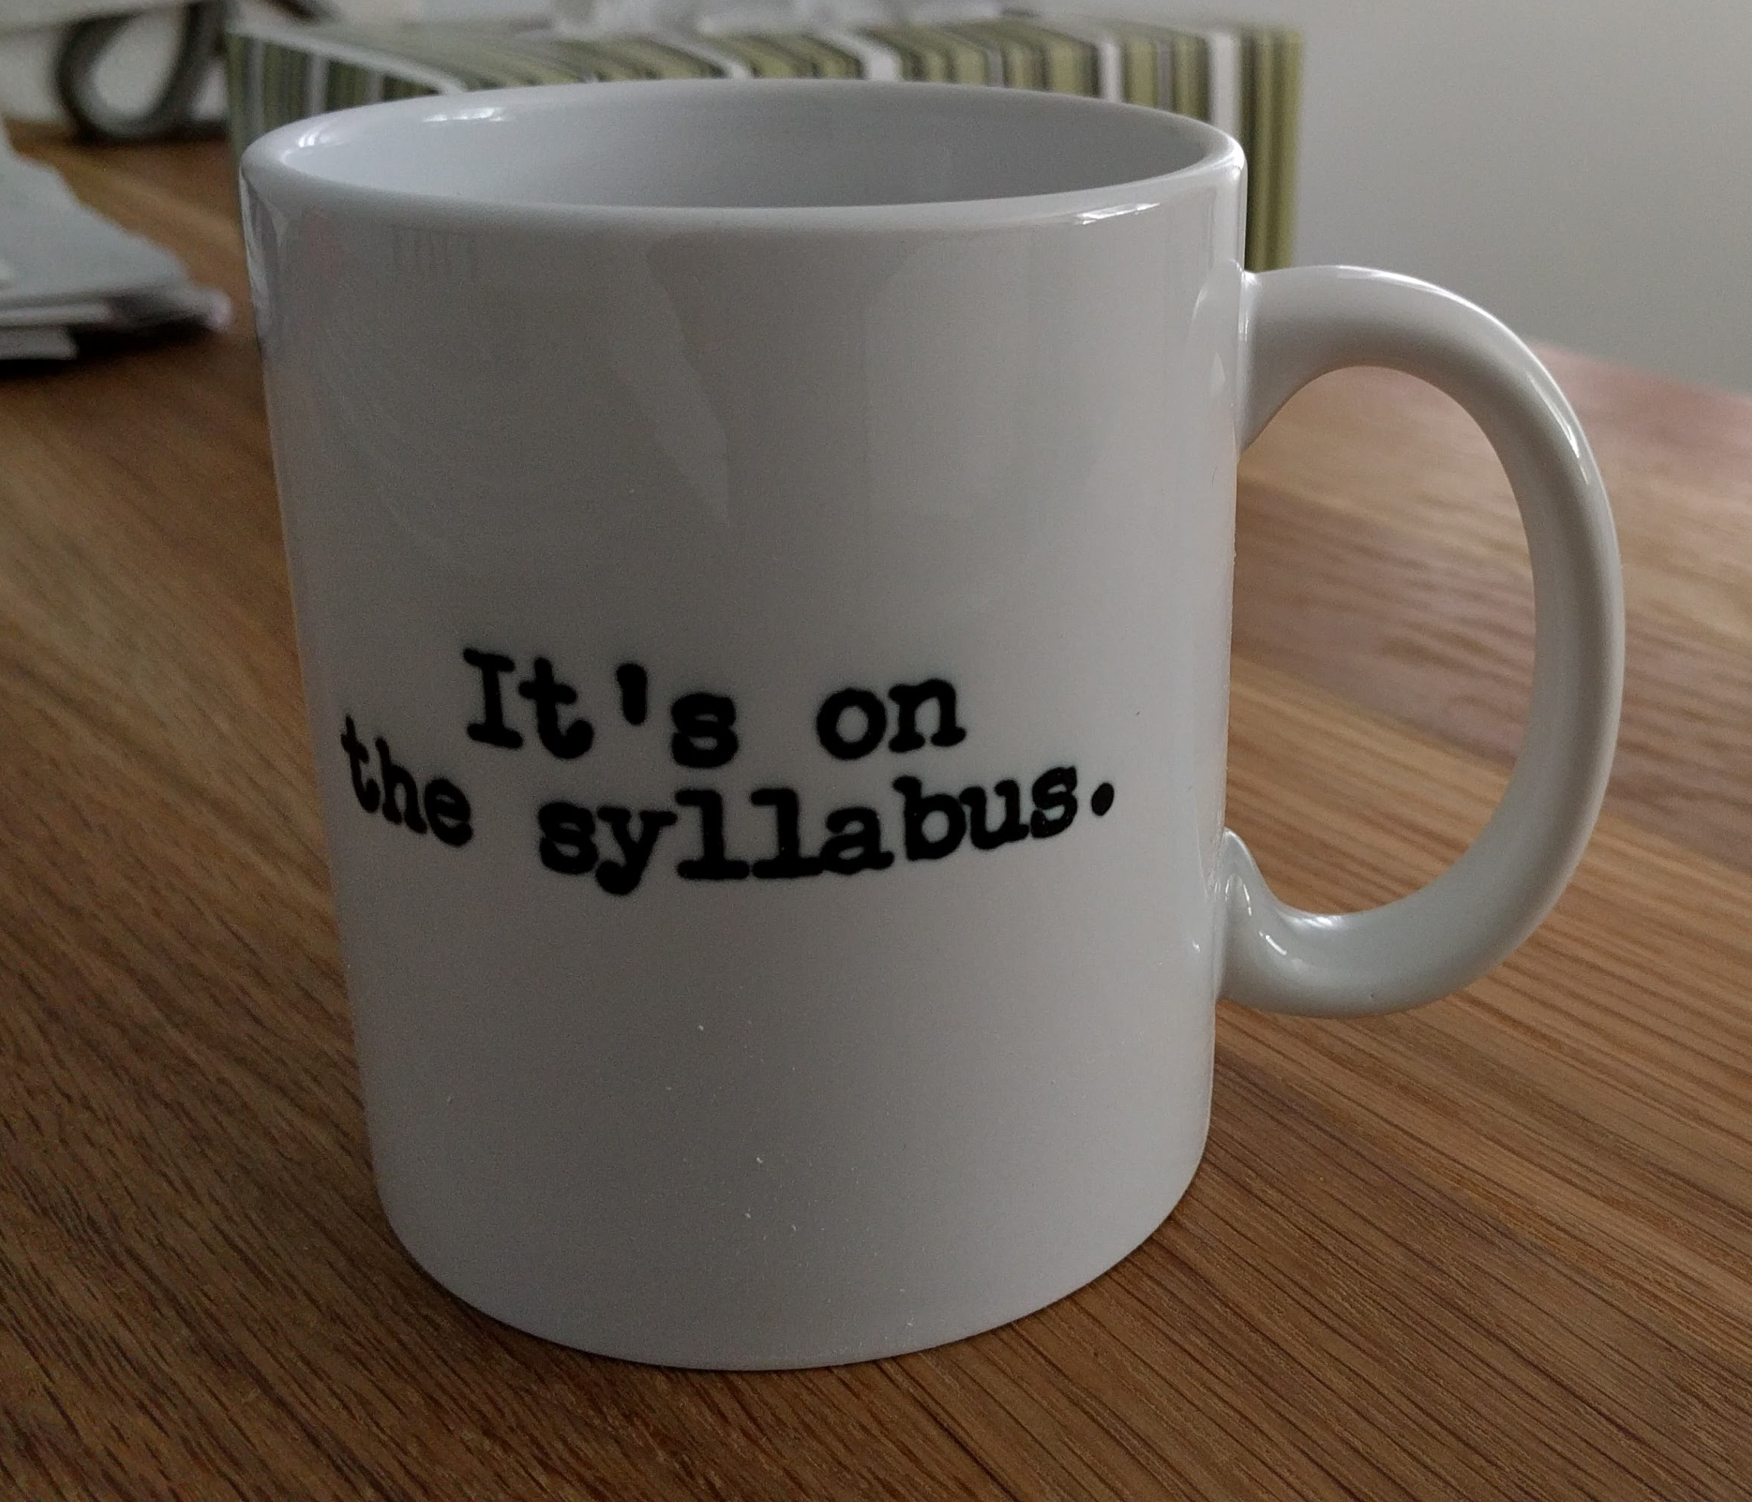
Syllabus Video
Discuss and Highlight Important Policies on the Syllabus
Contact Information
Course Objectives
University Policies
Course Policies
Late policy
Plagiarism
Schedule
This Photo by Unknown Author is licensed under CC BY-SA-NC

Slide 6
Orientation Video
Demonstrate first module
Show navigation
Stress where instructions located
Show where feedback located
Expectations
Turnaround time for email
When and how for feedback
How will you communicate?
Presence in the Course
How often do you expect them to login?
How much time is expected each week?
Notes:
Incorporate into three previous then remove.

Slide 7
Video Storage for Streaming
Studio or Tech Relay
Advantages
More private
Better auto captioning
Easy to edit for captioning accuracy
Can make interactive
Can use any software
Seamless insertion to LMS
Notes:
Karen

Slide 8
Help Forum: Encouragement to Use Them!
First Week Assignment
Copy and Paste Questions to Help Forum
Remind Students
Include reminder in announcements
Include link to Help Forum in modules
Create Help Forum for specific projects
Name it something fun!
Notes:
Sherrell:

Slide 9
Weekly Check-In!
Start week with a video announcement
Call or e-mail non-participants
Reminder announcements
Record zeros with comments
How can I help you?
Do we need to meet on Zoom so you can get on track?
Global announcement on grading completion with good points and improvement ideas
Notes:
Karen:
Start the slide and discuss
Sherrell: talks about her voice.

Slide 10
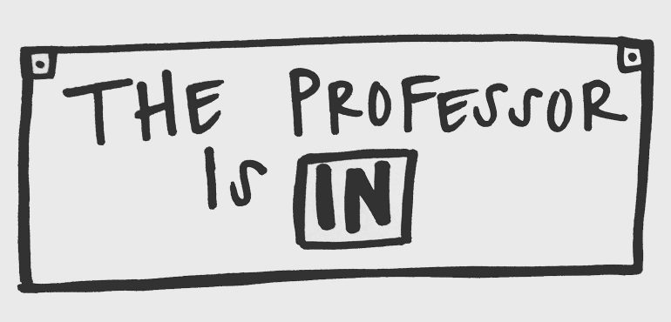
Virtual Office Hours
Mandatory Meet the Instructor
First two weeks
Give time options
Short 5-minute meeting
Graded
Post regular office hours in the Syllabus
Be available during those hours
Create a sign-up sheet
Notes:
Karen

Slide 11
Prepare Students for the Future
Present their assignments
Use PowerPoint recorder
Notes Pane
Webcam
Teamwork
"Tell me, and I forget. Teach me and I remember. Involve me and I learn.”
Benjamin Franklin
Notes:
Karen:
Discuss present assignments and PowerPoint recorder
Sherrell:
Start teamwork strategies and assignments early in the semester

Slide 12
Creative Assignments
Infographics
Contests
Best Image
Best Flyer, Brochure, etc.
Get Advisory Board involved
This Photo by Unknown Author is licensed under CC BY-SA-NC
Notes:
Karen
Creative assignments make better connections with learners
Sherrell
Audience Interaction

Slide 13
Journals
Gather feedback early in semester
Make small changes if needed
Make connections with struggling students
Give praise to those exceling
3 times during the semester
Notes:
Karen

Slide 14
Reflective/ Collaborative Assignments
Padlet
Jamboard
Notes:
Sherrell
Talk about discussions for collaboration
What should your presence be in your discussion?

Slide 15
Feedback
Video Feedback
Tell Students Where to Find Feedback
Ask Student To Respond to Feedback
Tells you they saw the feedback
Ask questions
Notes:
Sherrell
Karen

Slide 16
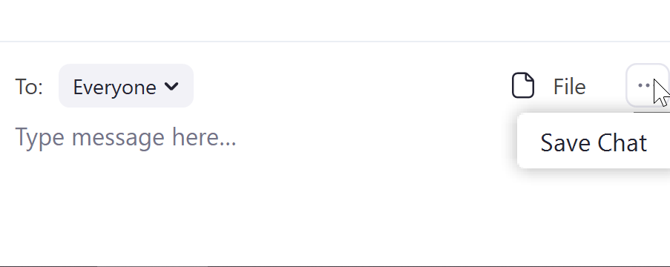
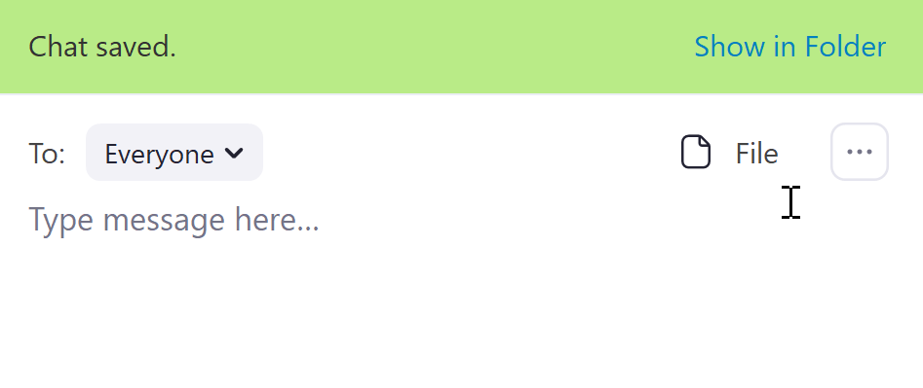
Save Chat!
Keep all the ideas by saving the chat

Slide 17
Thank you!
Karen May
kgmay@nmsu.edu
Sherrell Wheeler
swheeler@nmsu.edu

