Slide 1
Influence of APPQMR on Faculty Perceptions of QM and Their Course Design Abilities
Rhonda L. Gregory, Ed.D.
October 2018

Slide 2
Objectives
Explain the critical importance of faculty buy-in and support for quality assurance initiatives.
Appraise recent community college research about APPQMR's influence on faculty perceptions of QM.
Strategize how further faculty professional development and training should support quality control at their institutions.

Slide 3

Critical Factor: Faculty Buy-In
Esterhuizen et al., 2013
Hixon et al., 2011
Ragan & Schroeder, 2014
Shelton & Saltsman, 2005
Wingo et al., 2017

Slide 4

Problem
?
Notes:
Because Quality Matters has not been the focus of much research at the community college level, administrators don’t know if faculty participation in the Applying the QM Rubric workshop could significantly improve their course design abilities and perceptions of the rubric. So the underlying question behind this study was: “Is the APPQMR workshop effective for improving perceptions and course design abilities?

Slide 5
Relevance: DE Initiatives
Quality Assurance
Faculty acceptance/ buy-in
Training & development
Notes:
This is important because researchers, like McQuiggan and others, have shown that faculty members who participate in training are more likely to have the skills and mindset needed to make effective course design improvements.

Slide 6
Purpose
Explanatory sequential mixed methods
to examine the influence
of the APPQMR workshop on community college faculty members’:
perceptions of the QM rubric, and
their course design ability
Notes:
I chose an explanatory sequential mixed methods design because I intended to first conduct and analyze quantitative data, then use qualitative methods to help explain the results of the quantitative study in more detail.

Slide 7
Questions
Q1. How does APPQMR effect perceptions of the rubric?
Q2. What is the faculty experience in APPQMR?
|
What aspects helped or hindered
perceptions and design behaviors?
Q3. How do social influence & facilitating conditions
influence QM use long-term?
Notes:
My first research question was about how QM training effects participants’ perceptions of the rubric. I also asked faculty about their experiences in training and what aspects of it influenced their perceptions and skills. Finally, I asked how social influence and facilitating conditions affected their long-term adoption of QM.

Slide 8
Two Phases
P1
Causal-comparative quantitative design
  Q1: How does APPQMR effect perceptions?
Basic qualitative design
  Q1: How does APPQMR effect perceptions?
  Q2: What is the faculty experience? What influenced perceptions & course design?
  Q3: How do social influence & facilitating conditions influence QM use?
P2
Notes:
So, my study consisted of two phases: a causal-comparative quantitative design to investigate the first question about perceptions, followed by a basic qualitative design to further explain and explore question one – as well as to investigate questions 2 and 3.

Slide 9
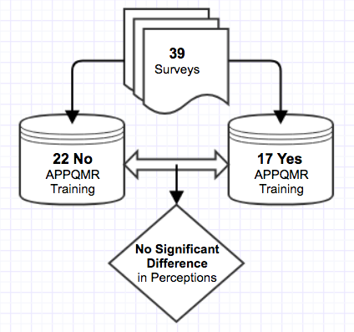
Phase One
Survey of faculty
  Two community colleges
  PU & PE
Two groups
  APPQMR (5 yrs.)
  No APPQMR
Notes:
In phase one, I conducted a survey of faculty at two community colleges regarding their perceptions of the QM rubric. Specifically, I measured perceived usefulness and perceived ease of use. Thirty-nine usable responses were collected and sorted into two groups based on whether or not the individuals had completed APPQMR within the last five years.

Slide 10
Phase One Select Characteristics to the nearest percentage
Training Group (n = 17)
Non-Training Group (n = 22)
29 Central Town
71 Sterling
47 high experience
12 no experience
65 F | 35 M
24 under age 45
82 Central Town
18 Sterling
41 high experience
50 no experience
46 F | 54 M
24 under age 45
Notes:
As you’ll see in the participant characteristics, Sterling Community College had a much higher percentage of faculty respond who had completed training than Central Town.
The percentage of faculty with a high level of training were about equal between groups, but the non-training group had a noticeably higher percentage of inexperienced faculty.
Age and gender were other demographic variables discussed, but the percentages were similar between groups in both categories.

Slide 11
P1 Findings
No significant difference of perceptions
  APPQMR training (M = 40.0, SD = 11.25)
  Non-training group (M = 36.09, SD = 9.75)
  t(37) = 1.16, p = .25, d = 0.375
Mann-Whitney U test verified results
  APPQMR training (Mdn = 22.71)
  Non-training group (Mdn = 17.91)
  U = 141.00, p = 0.191
Notes:
The results of this phase in the study showed that there was no significant difference in faculty perceptions between those who completed the QM training and those who did not. Because there were minor violations of normality for both groups and due to the small sample size, I confirmed the results using a Mann-Whitney U non-parametric alternative test.

Slide 12
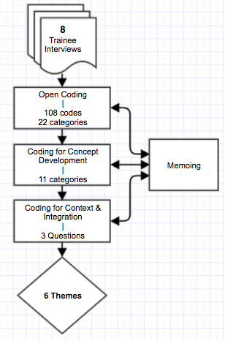
Phase Two
8 Interviews
  explain how training affected PE & PU
  describe experiences in training
  explore social influences and facilitating conditions
Notes:
Phase two was conducted immediately after the survey analysis. In this phase, I selected and interviewed eight faculty members from the training group. My goal was to help explain the quantitative results as well as to explore the second and third research questions about training experiences, social influences, and facilitating conditions. The flow chart you see depicts the coding and analysis process I followed as well as the funneling down of thematic conclusions, which I’ll discuss in more detail in a moment.

Slide 13
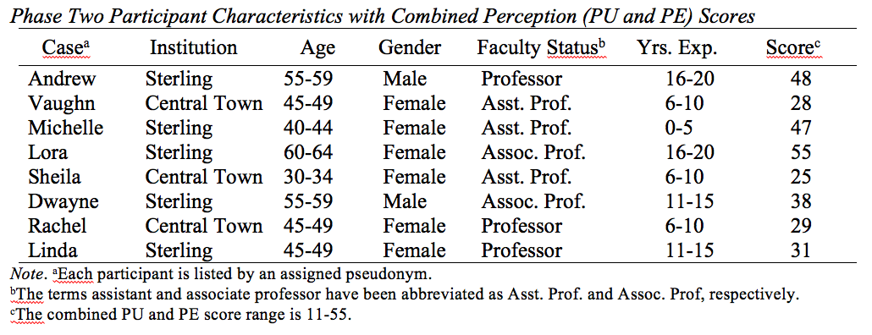
Phase Two Participants
Notes:
This chart outlines select demographics of phase two participants. While selecting individuals, I had to rely on self-identification and willingness to be interviewed, but tried to ensure maximum variation among the participants selected, particularly in terms of each person’s combined perception score, institution, age, and experience level.

Slide 14
Q1: Perception Theme
Training and provision of the QM rubric provided faculty with a useful, but not perfect, framework for course design.
Notes:
Results of the qualitative analysis led to the identification of 6 themes. For the sake of brevity, I’ll introduce each theme briefly and discuss them more in a moment before questions. The first theme related to perceptions of the rubric. That is, “Training and provision of the QM rubric provided faculty with a useful, but not perfect, framework for course design.” If I had to give it a grade based on the interviews, it would be a B+.

Slide 15
Q2: Experience Themes
Learning to apply QM principles and applying them to course design is rigorous and time-consuming.
Learning to apply the QM rubric through training provided a disorienting dilemma that resulted in the acquisition of knowledge and confidence to plan and make a change.
Notes:
The next two themes related to the faculty experience in APPQMR. In general, they reported that learning to apply QM principles through the workshop – and the act of applying the rubric to course design - are both rigorous and time-consuming. Nevertheless, learning to apply the QM rubric through training provided faculty members with a disorienting dilemma that resulted in the acquisition of knowledge and confidence to plan and make a change.

Slide 16
Q2 a/b: Key Aspects Themes
Accessibility was the most troublesome aspect of training.
Learning objective alignment was the most influential yet controversial aspect of training.
Notes:
When exploring the data, it become abundantly clear to me that accessibility of course materials was the most troublesome aspect of training. They felt that they wanted to know more about this topic, but were not given enough time or resources. I also found that QM’s intensive focus on learning objective alignment was the most influential aspect of training, despite this also being the most controversial topic mentioned.

Slide 17
Q3: SI & FC Theme
When QM is mandated, social influences and facilitating conditions significantly influence how faculty perceive and use the QM rubric.
Notes:
Finally, I found that when QM is mandated – as it was at both participating institutions – social influences and facilitating conditions significantly influence how faculty perceive and use the QM rubric.

Slide 18

Discussion
Training
=
Statistical significance on Perceptions
but
Practical significance on Perceptions and Skills
Perceptions
=
Ambiguous results
?
Notes:
So, going back to the research questions, there were a few key takeaways from the results that I’d like to mention from the discussion in chapter five. The first goes back to the first research question about perceptions and the somewhat ambiguous results of my quantitative and qualitative findings. It was interesting that I found no significant difference in faculty perceptions of the QM rubric like Mercer did in her dissertation a few years ago at a large research university. I noted in the paper how that contrasted with Budzick’s study at a community college. While there is some literature that suggests the ambiguous results could be related to experience level, gender, and age, there isn’t enough literature to support any definitive conclusions. At the same time, the literature and my interviews with faculty also showed that there is a practical significance of professional development in terms of transformational learning. The findings of my qualitative research indicate that there IS a practical significance of training. There were faculty who felt strongly on both sides of this topic, which helps to explain the lack of statistical significance in the perceptions survey.

Slide 19

Discussion 2
QM
=
Rigorous
+
Time Consuming
Learning Objective Alignment
+
Accessibility
Notes:
Another reason the effect of training is so difficult to quantify is because different individuals experience the same training different ways based on any number of factors. This was evident in the themes about faculty experience that arose from faculty interviews. The analysis revealed that it is rigorous to use the QM rubric – and to learn to use it. It takes time and effort to do so. Not all faculty agreed that the time and content covered in training was worthwhile.
{Transition}
For instance, they expressed mixed feelings about the value of creating learning objectives and aligning them to course materials and assessments. A few saw this aspect of QM as being too educator-oriented, But most felt that they changed the way they view and develop courses as a result of this information. The majority also discussed the importance of accessibility and how they felt ill-prepared to deal with it correctly. These findings are supported in the literature today. For some faculty in this study, QM training was truly a transformative experience.

Slide 20

Discussion 3
Social Influence
+
Facilitating Conditions
→
Perceptions
&
Behaviors
Notes:
Conducing this study was fascinating to me. That’s largely because the comments from the faculty at these two institutions – both the positive and the negative ones - so closely mirror what faculty say at my own college. Some love QM, some hate it, and many are somewhere in between. This speaks to the importance of factors like social influence – which is based on what they’ve heard from others - and facilitating conditions – which includes the support they’ve experienced. Combined, both factors seemed to strongly influence many of the faculty opinions in my interviews. The two colleges represented in this study unexpectedly ended up serving as almost two case studies to learn from when implementing QM standards. Although I chose to explore these constructs qualitatively, the results aligned with other researchers that social influence and facilitating conditions have an effect on perceptions and user behaviors. In general, faculty need to have the support of their colleagues and administrators as well as various forms of ongoing institutional support when QM is mandated for course design.

Slide 21
Implications
Perceptions can be influenced via APPQMR, but also by the social influences and context of the environment.

Slide 22

Enhance APPQMR
Allow focus options after the essential standards are introduced
LOs and alignment:
  Improve explanation
  Use exemplars
  Establish relevance
Increase time estimate
Notes:
QM might enhance the APPQMR workshop, such as integrating self and peer evaluations into the curriculum to more explicitly align with principles of adult learning theory.
Specifically, QM may want to allow participants some options about which aspects of the rubric they want to focus on after the essential standards are introduced in training. Allowing choice and raising participants’ levels of autonomy would strengthen the workshop’s alignment with adult learning theory and constructivism.

Slide 23
Scaffold Around APPQMR
Before:
  Mentors introduce QM and alignment to new developers
  Showcase exemplars
During:
  Hold small group support sessions
  Reach out to individuals
After:
  1:1 ID or Mentor support/consultation
  Professional services (e.g., captioning, formatting)
  In-house trainings
  Communities of practice
Notes:
Institutions may need to create a more comprehensive approach to their quality assurance plans that includes training, ongoing support, and evaluation of course delivery.

Slide 24

Extend Communication!
Extended internal and external communication needed:
  Explain it
  Support it
  Let faculty lead it
Notes:
Overall, I feel that the greatest implication resulting from this study is is the need for an effective faculty communication plan when QM is adopted – particularly when it is mandated. The faculty need to understand the initiative well enough to buy-into it, and they need to know they are supported in their work.

Slide 25

Let’s Talk
What forms of faculty PD best support quality control initiatives at your institutions?

Slide 26

Closing Slide
Dr. Rhonda Gregory
Rhonda.Gregory@volstate.edu
Twitter: @RhondaGregory

