Slide 1

Strategies for Embedding Academic Support Resources in Online Courses
Quality Matters Regional Conference
April 20-21, 2017
Berkeley College
New York, NY

Slide 2
Presenters
Patricia Cowan, Faculty Member, School of Liberal Arts
Charles Lamont Eddins, Instructional Designer, Larry L. Luing School of Business
Chris Grevesen, Dean, School of Graduate Studies
Julie Hunter, Online Research & Instruction Librarian

Slide 3
Background
First online deployment of an MBA Practicum course in Fall 2016
Need for building block pedagogy in seven-week accelerated format
Students needed expert assistance with research and writing as well as faculty guidance on application of disciplinary concepts
Berkeley College offers learning resources to online faculty and students, including Instructional Designers, Research Librarians and Writing Consultants
QM Standard 7.3 provided the idea for collaborative embedding of research librarian and writing consultant

Slide 4
QM Standard 7.3
“Course instructions articulate or link to an explanation of how the institution’s academic support services and resources can help learners succeed in the course and how learners can obtain them.”

Slide 5
The Online Learner Support Team at Berkeley College
learner
Instructor
Research Librarian
Instructional Designer
Writing Consultant

Slide 6
360 Degree Collaboration
Instructor
Instructional Designer
Writing Consultant
Research Librarian

Slide 7
Interactive Session
(Twenty Minutes)
Participants form breakout groups of 3-4 members
Groups are provided with a brief course description and an online course template to use as a worksheet
Each group identifies 3 specific ways that online learning support resources, such as writing consultants, tutors and librarians can be embedded into the online course—QM Standard 7.3 should serve as a guidepost
All participants reconvene to share ideas

Slide 8
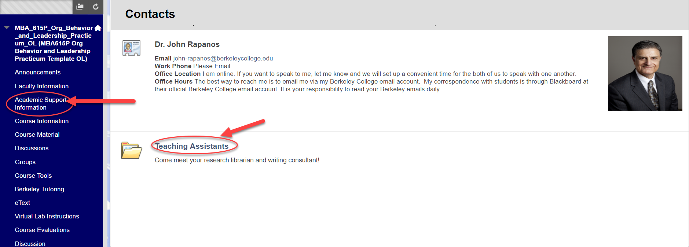
Examples of Resource Embedding from Berkeley Practicum Course: Contact Information

Slide 9
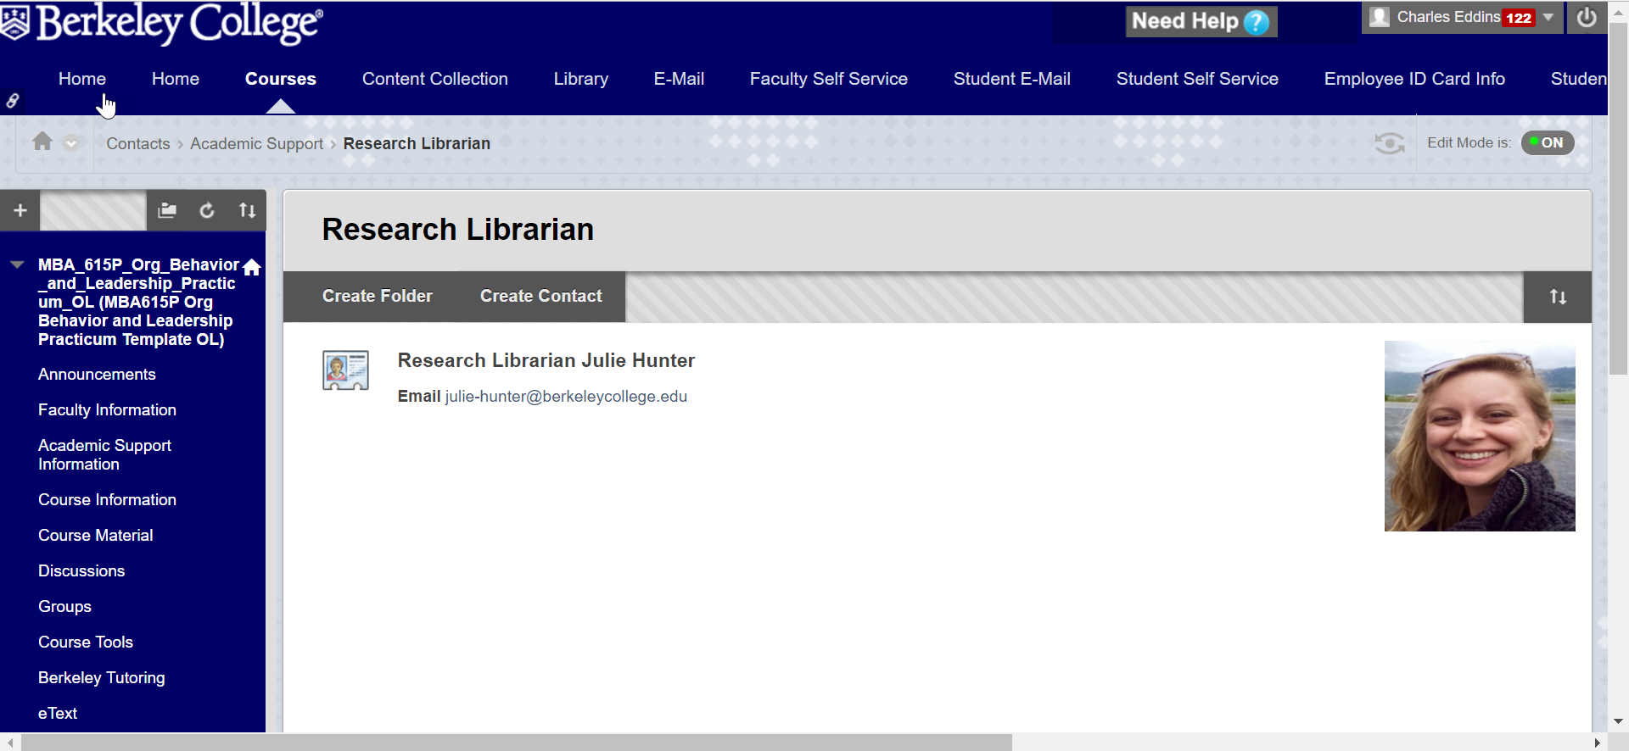
Examples of Resource Embedding from Berkeley Practicum Course: Contact Information

Slide 10
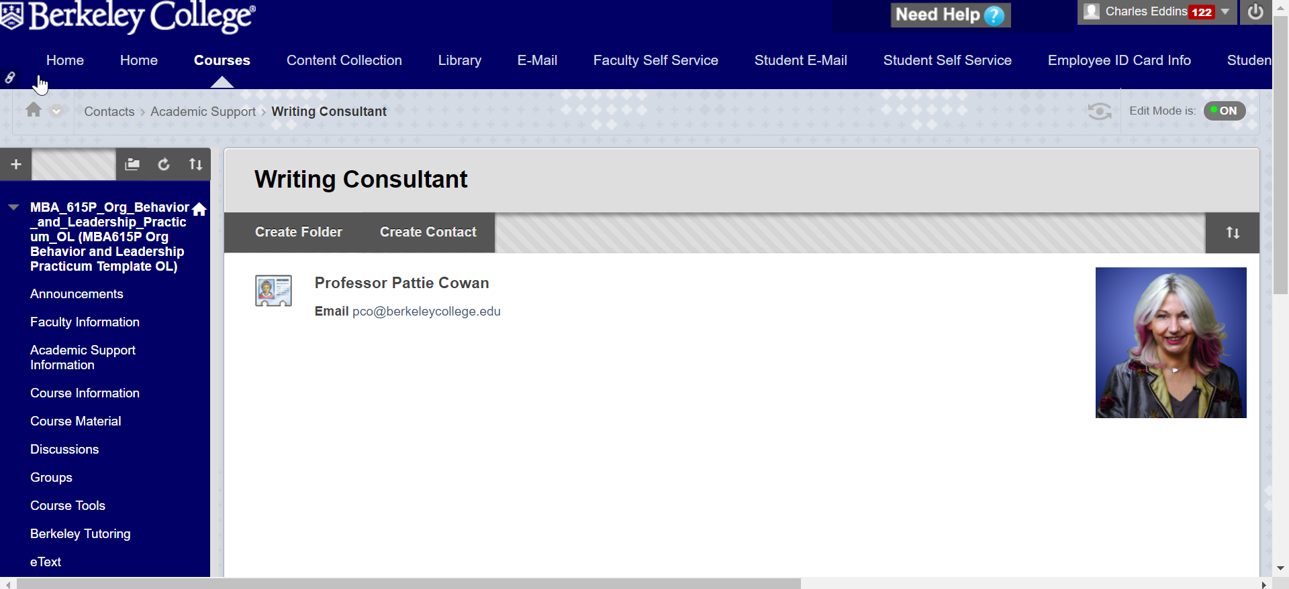
Examples of Resource Embedding from Berkeley Practicum Course: Contact Information

Slide 11
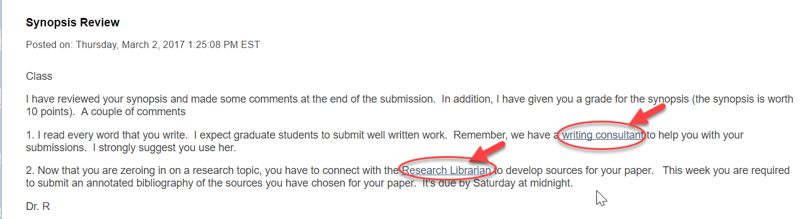
Examples of Resource Embedding from Berkeley Practicum Course: Announcements

Slide 12
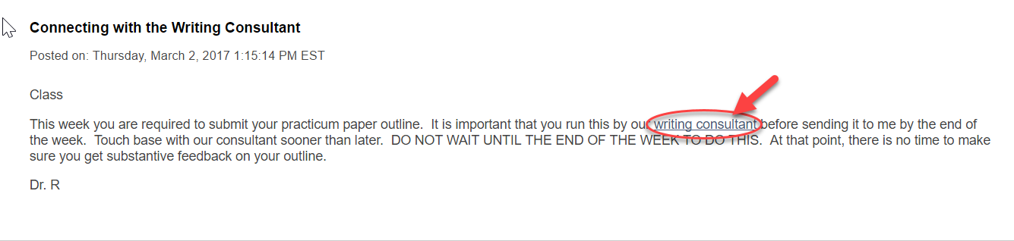
Examples of Resource Embedding from Berkeley Practicum Course: Announcements

Slide 13
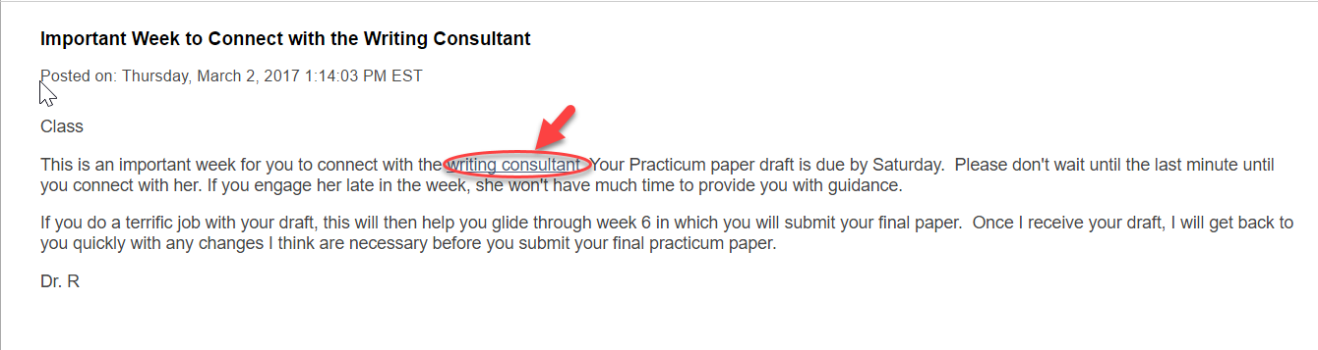
Examples of Resource Embedding from Berkeley Practicum Course: Announcements

Slide 14
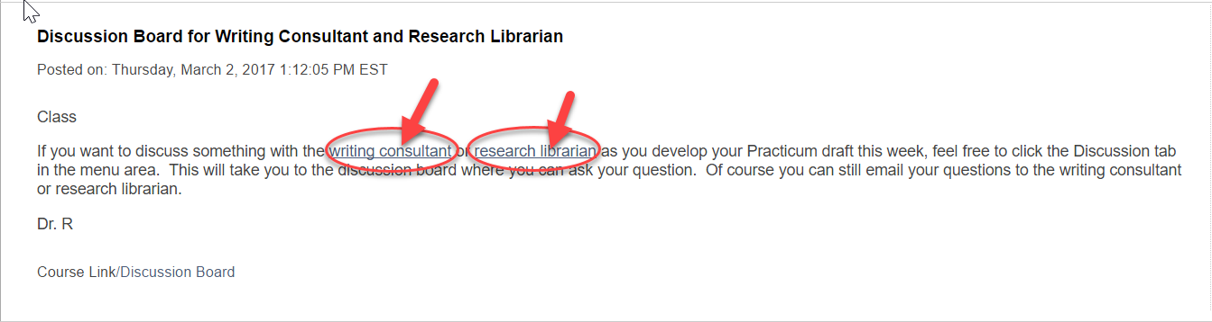
Examples of Resource Embedding from Berkeley Practicum Course: Discussion Boards

Slide 15
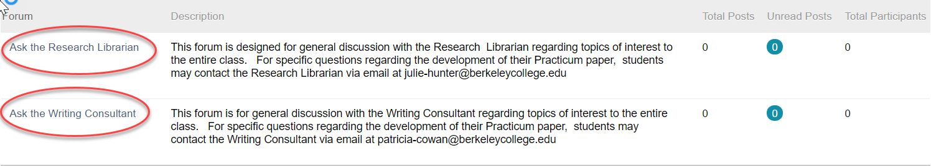
Examples of Resource Embedding from Berkeley Practicum Course: Discussion Boards

Slide 16

Examples of Resource Embedding from Berkeley Practicum Course: Forums

Slide 17
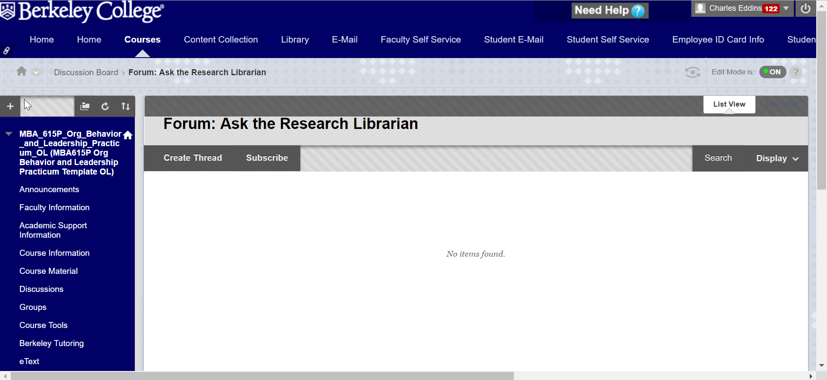
Examples of Resource Embedding from Berkeley Practicum Course: Forums

Slide 18
Suggested Reading
Blake, L., Ballance, D., Davies, K., Gaines, J. K., Mears, K., Shipman, P., … Burchfield, V., (2016). Patron perception and utilization of an embedded librarian program. Journal of the Medical Library Association, 104(3), 226-230. http://dx.doi.org.ezproxy.library.berkeley.org/10.3163/1536-5050.104.3.008
Burke, J. J., & Tumbleson, B. E. (2016). LMS embedded librarianship and the educational role of librarians. Library Technology Reports, 52(2), 5-9, 2. Retrieved from http://search.proquest.com.ezproxy.library.berkeley.org/docview/1768314130?accountid=38129
Calkins, K., & Kvenild, C. (Eds.). (2014). The embedded librarian's cookbook. Chicago, IL: Association of College and Research Libraries.
Lemley, T. (2016). Virtual embedded librarianship program: A personal view. Journal of the Medical Library Association, 104(3), 232-234. http://dx.doi.org.ezproxy.library.berkeley.org/10.3163/1536-5050.104.3.010
Pagnac, S., Boertje, C., Bradfield, S., McMahon, E., & Teets, G., (2014). An Embedded model: First-year success in writing and research. Praxis: A Writing Center Journal. 12(1), 39-44. Retrieved from https://repositories.lib.utexas.edu/bitstream/handle/2152/31523/12.1CourseEmbeddedWritingSupportPrograms.pdf?sequence=2&isAllowed=y
Sharma, P., Kumar, K., & Babbar, P. (2014). Embedded librarianship: Librarian faculty collaboration. DESIDOC Journal of Library & Information Technology, 34(6). Retrieved from http://search.proquest.com.ezproxy.library.berkeley.org/docview/1645696130?accountid=38129
Titus, M., Scudder, J., Boyle, J., & Sudol, A. (2014). Dialoging a successful pedagogy for embedded tutors. Praxis: A Writing Center Journal. 12(1), 15-20. Retrieved from https://repositories.lib.utexas.edu/bitstream/handle/2152/31523/12.1CourseEmbeddedWritingSupportPrograms.pdf?sequence=2&isAllowed=y
Webster, K., & Hansen, J. (2014). Vast potential, uneven results: Unraveling the factors that influence course-embedded tutoring success. Praxis: A Writing Center Journal. 12(1), 51-56. Retrieved from https://repositories.lib.utexas.edu/bitstream/handle/2152/31523/12.1CourseEmbeddedWritingSupportPrograms.pdf?sequence=2&isAllowed=y
Wu, L., A., Betts, V. T., Jacob, S., Nollan, R., & Norris, T. (2013). Making meaningful connections: Evaluating an embedded librarian pilot project to improve nursing scholarly writing. Journal of the Medical Library Association, 101(4), 323-6. Retrieved from http://search.proquest.com.ezproxy.library.berkeley.org/docview/1491275986?accountid=38129

Slide 19
Questions & Discussion

