Slide 1
Designing for All,
It’s All in the Design
QM Conference
October 31, 2018
Slides - bit.ly/DesignforAll
Intros - bit.ly/DesigningIntro
#QMConnectWorthIt

Slide 2
Kim Hendrick
@evolvewithkim
Director of Innovation
Indiana Online | CIESC

Slide 3
Laura Garmire
@LauraGarmire
Virtual Learning Specialist
Indiana Online | CIESC

Slide 4
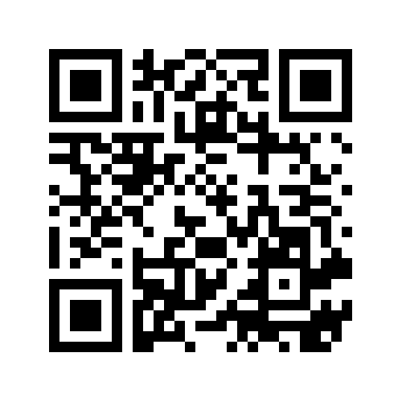
Session Goal & Introductions
Understand the importance of designing for all learners and gain an understanding of different accessibility tools to check your content.
bit.ly/DesigningIntro
#QMConnectWorthIt

Slide 5
Why?
"Though estimates vary, most studies find that about one fifth (20%) of the population has some kind of disability. Not all of these people have disabilities that make it difficult for them to access the internet, but it is still a significant portion of the population. Businesses would be unwise to purposely exclude 20, 10, or even 5 percent of their potential customers from their web sites. For schools, universities, and government entities it would not only be unwise, but in many cases, it would also violate the law." via webaim.org
Notes:
kim

Slide 6
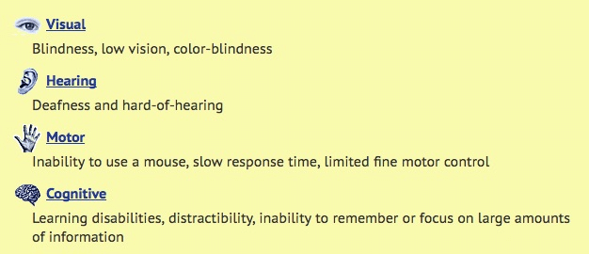
Major Categories of Disabilities

Slide 7
Accessible Technologies
Accessibility ensures both equal access and equal opportunity for your audience, whether students, parents, educators, or other stakeholders. Equal access and equal opportunity to content, programs, resources, and learning platforms is a legal obligation, but also it ensures that your content is usable by all. Accessible technologies might include:
Websites
Online learning portals and platforms
Videos posted online
Digital textbooks and e-book readers
Student or parent portals for scheduling, billing, or notifications

Slide 8
Why is Design Important?
Standard 8

Slide 9
Standard 8
The course design reflects a commitment to accessibility, so all learners can access all content and activities, and to usability, so that all learners can easily navigate and interact with all course components.

Slide 10
Standard 8
8.1 Navigation throughout the course is logical, consistent, efficient, and intuitive. (3)
8.2 Information is provided about the accessibility of all technologies required in the course. (3)
8.3 The course provides alternative formats of course materials that meet the needs of diverse learners in order to accommodate alternative means of access. (2)
8.4 The course design facilitates readability. (2)
8.5 Course multimedia facilitate ease of use. (2)
Notes:
Examples of students: who might take an online course.
Blind student take US Govt, Econ, Psych
Deaf student Spanish, us govt, english
student losing hearing taking ASL
Our own material needs to be accessible for deaf teacher

Slide 11
Accessibility Checker
Webaim web page
WAVE extension - both Chrome and Firefox
Notes:
Laura - check their website

Slide 12
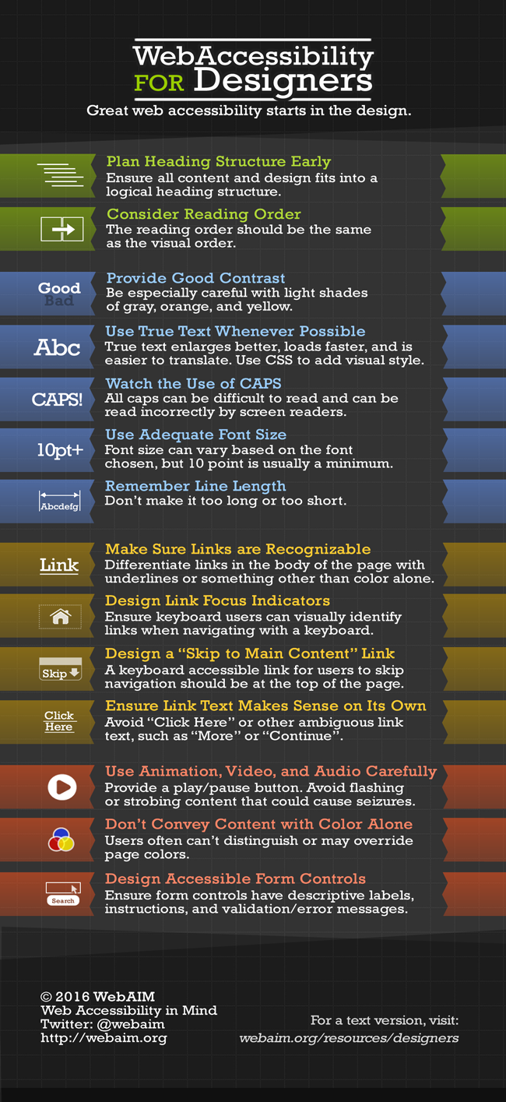

Slide 13
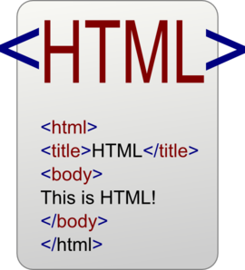
Types of Content
Notes:
Laura

Slide 14
Notes:
Laura Alt text or caption depending on your graphic

Slide 15
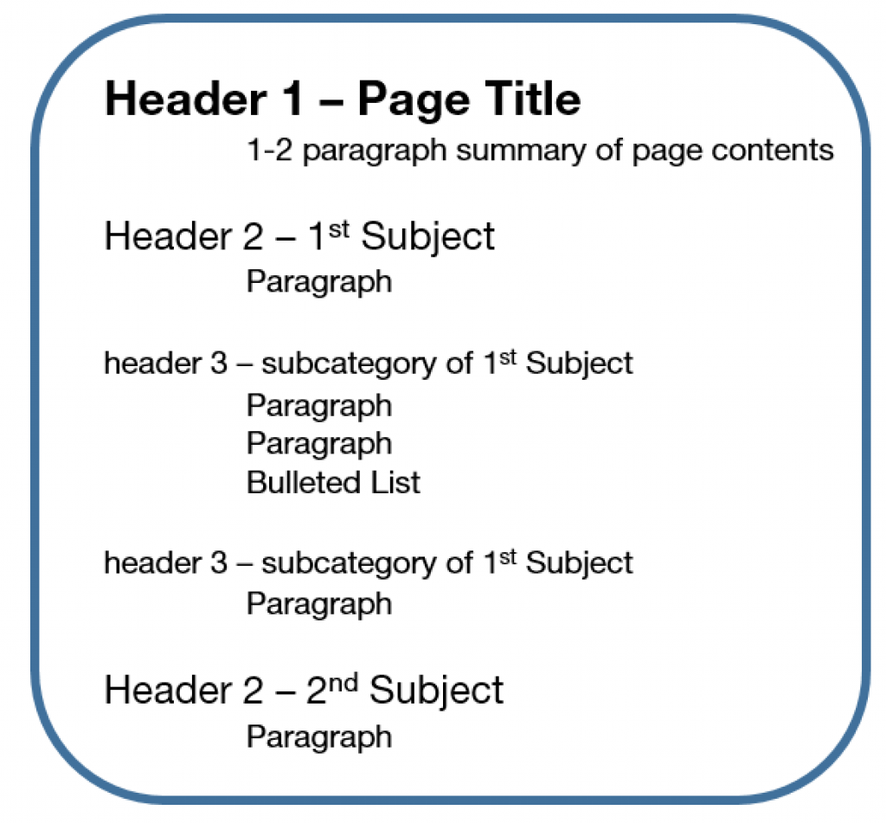
Document Structure
Headers
Use layouts in PPT and Slides
Notes:
Laura
keep to PP layouts example arrow pointing to added text box - screen reader not going to know how to read it
For example, imagine using a word-processing program to type a block of text with a title. To distinguish the title from the text, a user might enlarge the font and make it bold. Those changes are visual clues that those words should be considered separately from the text that follows. But those visual changes on a website mean nothing to screen-reader programs without embedded codes that tell software that certain words are meant to be a header. Without such coding, screen readers only see an undifferentiated block of text.

Slide 16
Document Structure
Bullets vs. Numbered List: bullets are just a list order makes no sense, numbers means that it is sequential and they have to go in that order. Screen readers will say the number but not read a bullet which can cause confusion.
Notes:
Laura
keep to PP layouts example arrow pointing to added text box - screen reader not going to know how to read it

Slide 17
Accessibility Checker
Accessibility for Docs, Slides, Sheets editors
Readers, Magnifying, and Braille
Microsoft Word
Review tab
Check Accessibility
Notes:
Laura - check their website

Slide 18
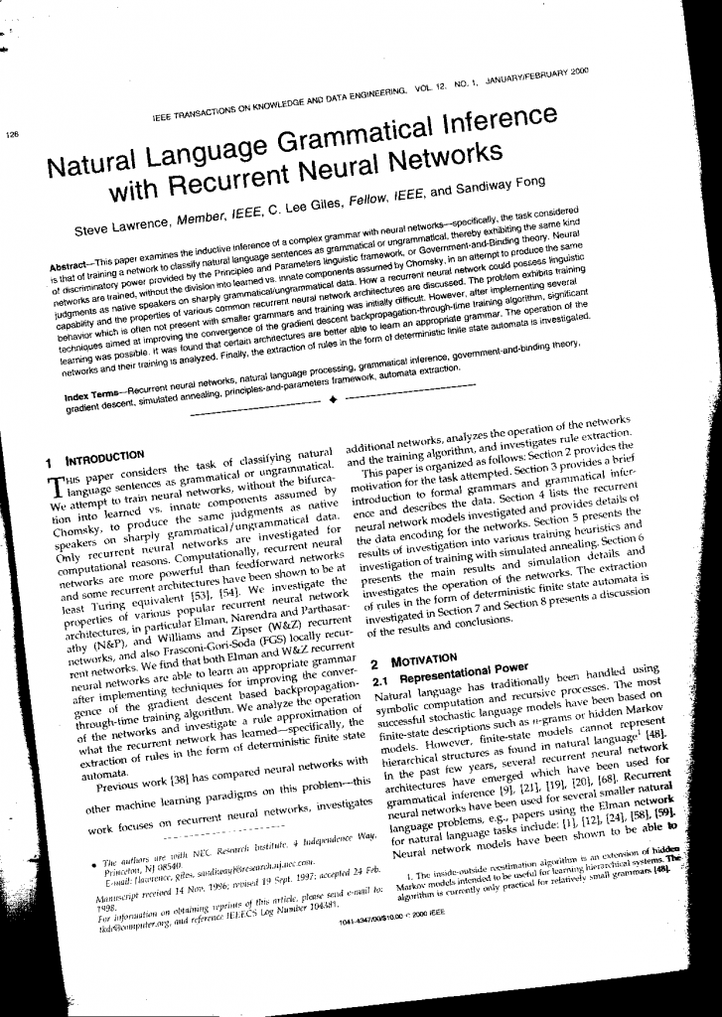
Scanned docs
Is it text or a graphic?
Does anyone want to read this?
Can a screen reader read this?
#whatnottodo

Slide 19
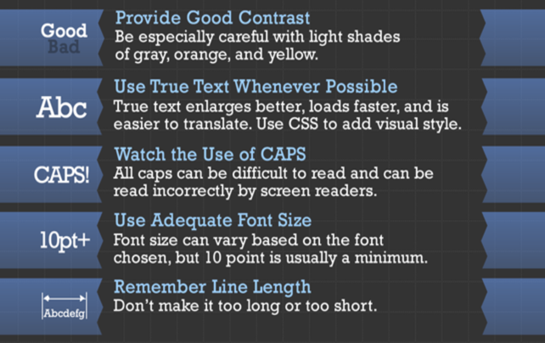

Slide 20
PLEASE BE CAREFUL WITH ALL CAPS!
Watch the color contrast.
Is it hard to read?
Size does matter
Is your font too small?
Notes:
in a word or docs if heading are used ALL Caps are ok and the font that changes it to all caps - will read correctly
Large font gets distorted when students use the magnifier

Slide 22
Click here
Examples:
https://docs.google.com/presentation/d/1nPAf7qessA7ZrWS03xPhnMLtLg4cLbShpm_dib3Js1g/edit#slide=id.g43920e9d97_3_117
Please reference the Designing Presentation.
You should see this! - careful w/ underlining!!!

Slide 23
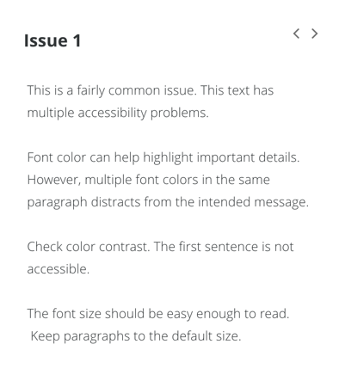
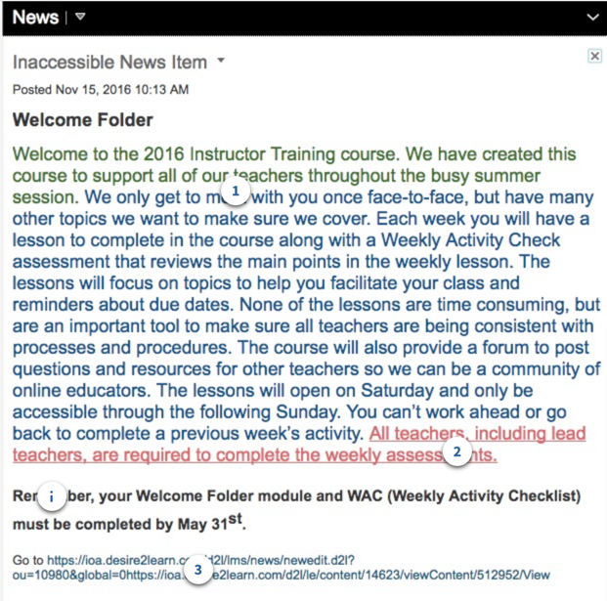
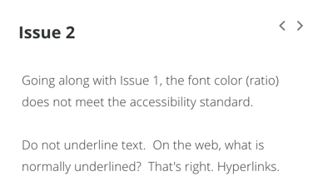
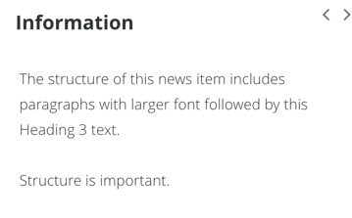
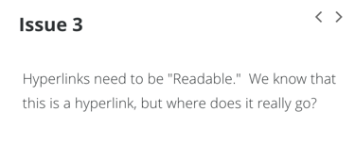

Slide 24
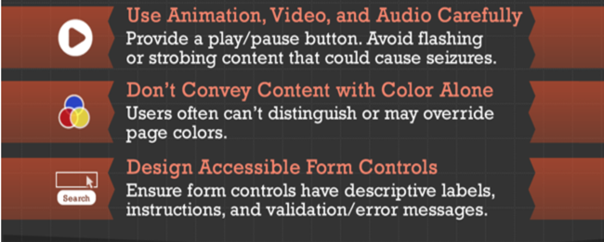

Slide 25
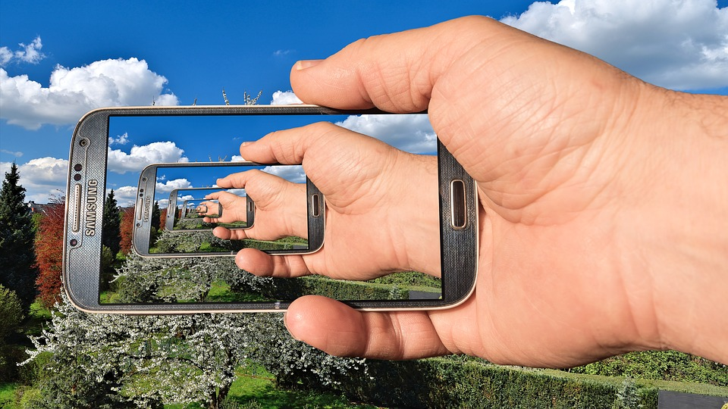
Images
Decorative or Informative?
Use layouts in PPT and Slides
Charts and graphs
Notes:
Laura
Images present a similar problem. An accessible website would include a specially coded image description. Without that coding, a screen reader will only spit out a file name, such as
"school_123.jpg."

Slide 26
Please don’t!!! Whatever you do, please resist the temptation!

Slide 27
Pop Quiz!
Let’s test your knowledge with this H5P interactive.
How did you do?

Slide 28
Let’s Collaborate!
Add your own websites, programs, and tips to our crowdsource document!

Slide 29
khendrick@indianaonline.org ~ lgarmire@indianaonline.org

