Slide 1
Connecting QM Program Certification & HLC Open Pathway Quality Initiative
Lisa Clark Ph.D
Associate VPAA & Dean of Online Programs
University of Northwestern Ohio (UNOH)

Slide 2
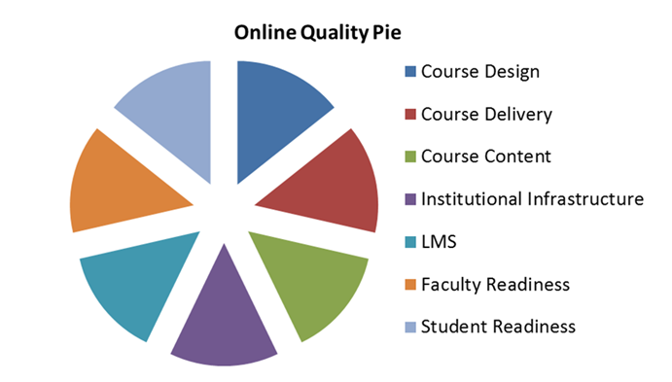
Making Connections between initiatives
2015 Centralized oversight of online programs (gave our Virtual College a home)
Dean of Online Programs Developed
Copyright Quality Matters

Slide 3
Making Connections between initiatives
Late 2017 promoted to Associate VPAA
Ongoing initiatives
Assessment
Program review
Professional development
Accreditation

Slide 4
Higher Learning Commission (HLC) Requirements
UNOH is in the HLC Open Pathway
10 year cycle
Various checkpoints along the way
Quality Initiative Required

Slide 5
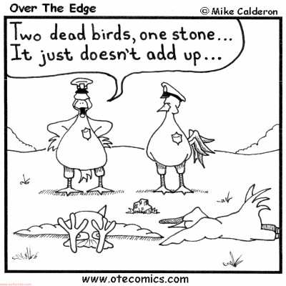
Merging QA Initiatives
Quality Assurance Initiatives
Quality online programs (2015)
Maintaining good standing with regional accrediting body (2016)
Fulfilling plans from previous report
Benefits to Merging
Avoid Resource Duplication
Working with previously validated initiatives

Slide 6
Goals
Building the 2026 reaffirmation of accreditation assurance argument
Improving the online learner experience at UNOH

Slide 7
Overlap = Same Outcomes
Overlap
QM Program Reviews
Online Program Design
Online Teaching Support
Online Learner Support
Online Learner Success
Data Collection- 3 years
Shared Outcomes
Recognized stamp of quality
Data driven decisions
Matches HLC expectations

Slide 8
Next Steps
Submit quality initiative proposal to HLC (2021)
Complete original 5 year strategic plan for UNOH online (year 5- 2019)
Year 5 has a focus on data analysis
Develop the next phase of the strategic plan for UNOH online that reflects both the QM Program Review Initiative & the HLC Quality Initiative
Both initiatives due to be completed during years 5-9 of our accreditation cycle (2021-2025)

Slide 9
Questions?
lclark@unoh.edu
Thank you for attending this session!

Slide 10
Connecting QM Program Certification & HLC Open Pathway Quality Initiative
Lisa Clark Ph.D
Associate VPAA & Dean of Online Programs
University of Northwestern Ohio (UNOH)

Slide 11
Making Connections between initiatives
2015 Centralized oversight of online programs (gave our Virtual College a home)
Dean of Online Programs Developed
Copyright Quality Matters

Slide 12
Making Connections between initiatives
Late 2017 promoted to Associate VPAA
Ongoing initiatives
Assessment
Program review
Professional development
Accreditation

Slide 13
Higher Learning Commission (HLC) Requirements
UNOH is in the HLC Open Pathway
10 year cycle
Various checkpoints along the way
Quality Initiative Required

Slide 14
Merging QA Initiatives
Quality Assurance Initiatives
Quality online programs (2015)
Maintaining good standing with regional accrediting body (2016)
Fulfilling plans from previous report
Benefits to Merging
Avoid Resource Duplication
Working with previously validated initiatives

Slide 15
Goals
Building the 2026 reaffirmation of accreditation assurance argument
Improving the online learner experience at UNOH

Slide 16
Overlap = Same Outcomes
Overlap
QM Program Reviews
Online Program Design
Online Teaching Support
Online Learner Support
Online Learner Success
Data Collection- 3 years
Shared Outcomes
Recognized stamp of quality
Data driven decisions
Matches HLC expectations

Slide 17
Next Steps
Submit quality initiative proposal to HLC (2021)
Complete original 5 year strategic plan for UNOH online (year 5- 2019)
Year 5 has a focus on data analysis
Develop the next phase of the strategic plan for UNOH online that reflects both the QM Program Review Initiative & the HLC Quality Initiative
Both initiatives due to be completed during years 5-9 of our accreditation cycle (2021-2025)

Slide 18
Questions?
lclark@unoh.edu
Thank you for attending this session!

